Slide 1
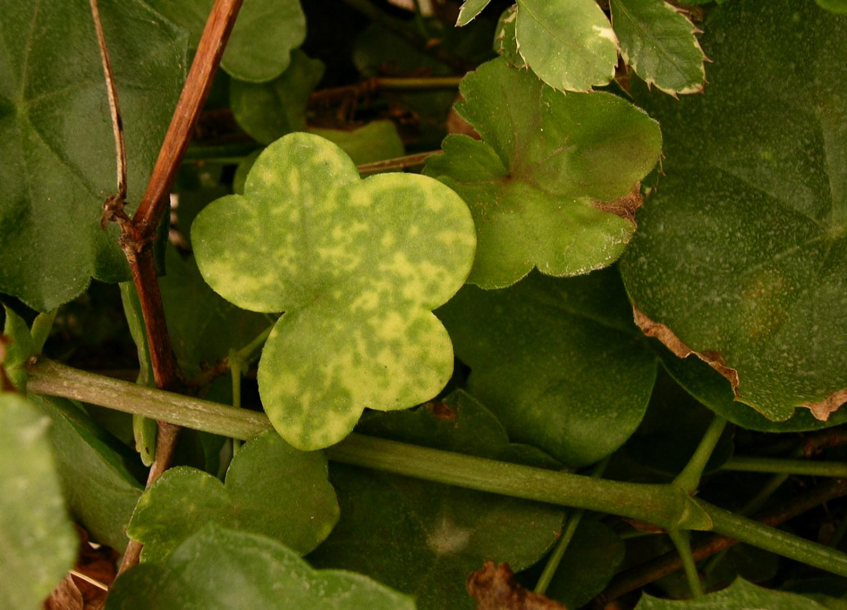
MODULE 1
HOW TO BECOME A PLANT DOCTOR
Eric Boa, CABI
6. BEING A DETECTIVE
© CAB International 2012
PLANTWISE TRAINING. MODULE 1: HOW TO BECOME A PLANT DOCTOR. BEING A DETECTIVE: LEARNING MORE ABOUT CAUSES
Notes:
This presentation describes the essence of field diagnostics. Make sure you take it at a pace so that they can take it all in. It is quite a long presenation but take your time when presenting. This is the essence of module 1. It is immediately after this presentation that the large A3 ready reckoner should be presented. There are two exercises that form part of this presentation. You need to have practiced this presentation and become familiar with it.

Slide 2
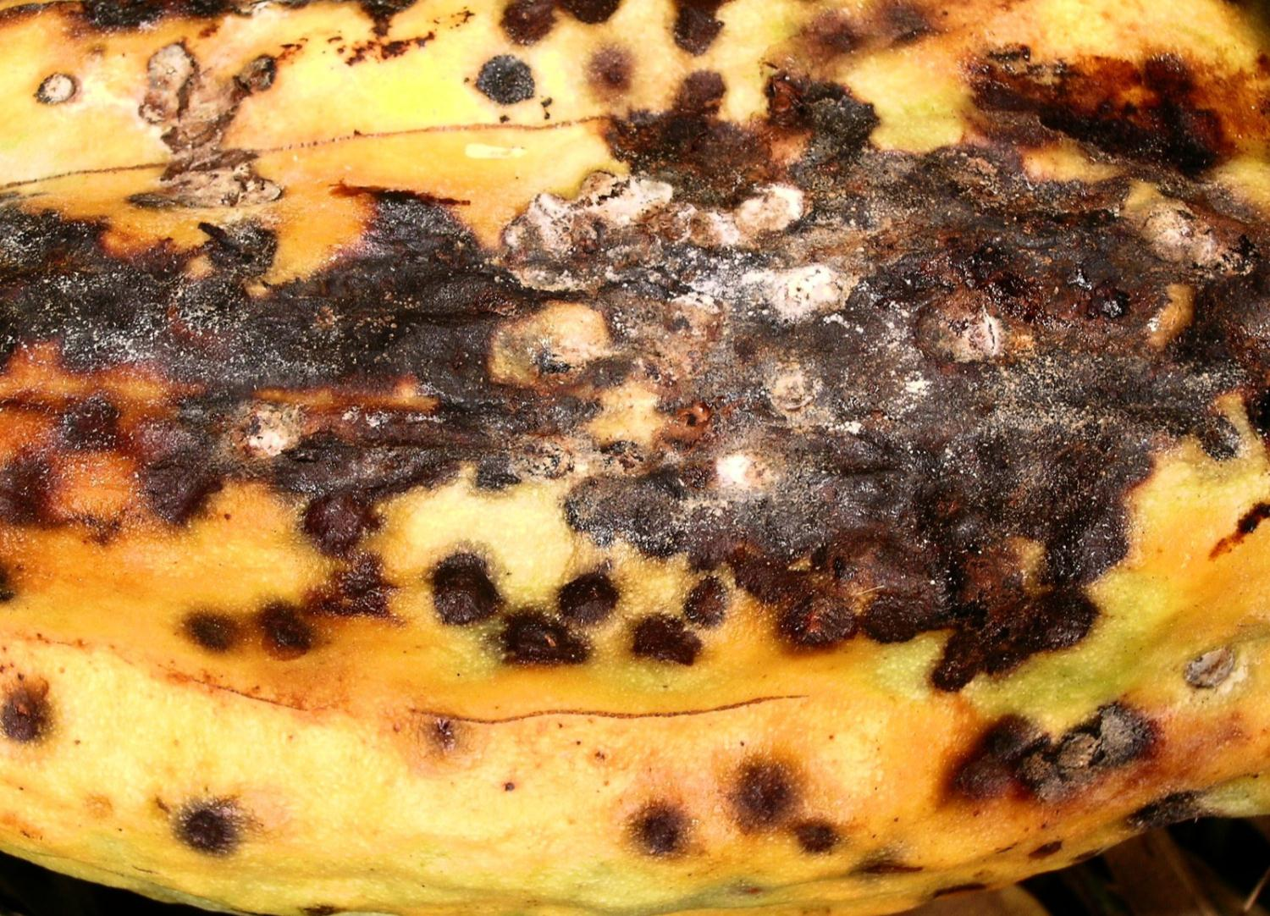
CAUSES
PLANTWISE TRAINING. MODULE 1: HOW TO BECOME A PLANT DOCTOR. BEING A DETECTIVE: LEARNING MORE ABOUT CAUSES
Notes:
A filler slide of little importance: move on.

Slide 3
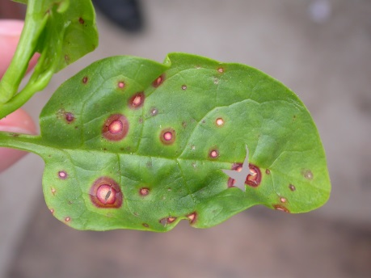
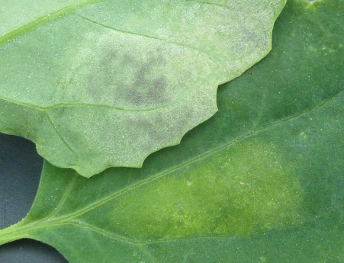
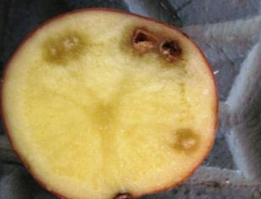
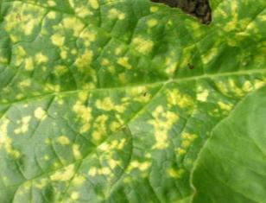
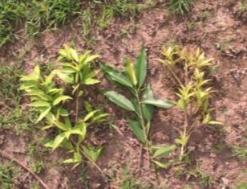
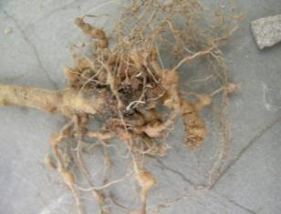
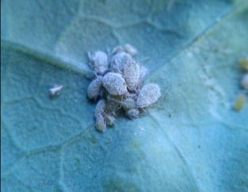
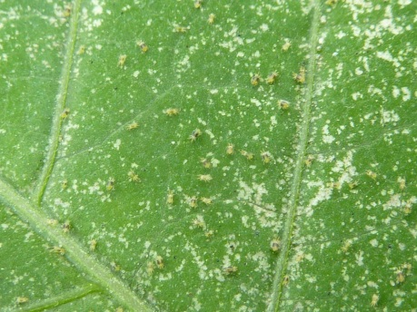
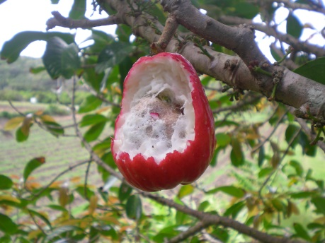
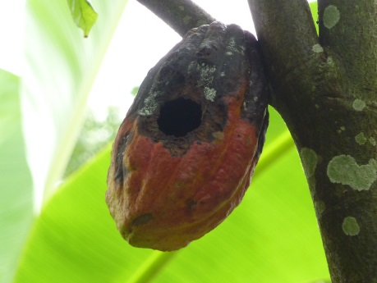
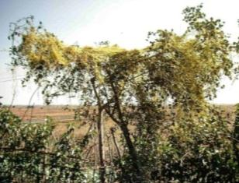
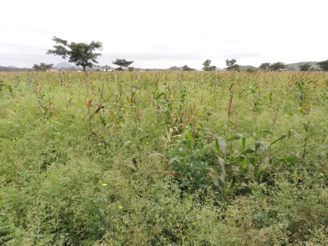
BIOTIC
PESTS AND DISEASES
fungus
water moulds
bacteria
virus
phytoplasma
nematode
insects
mites
birds
animals
parasitic plant
weeds
PLANTWISE TRAINING. MODULE 1: HOW TO BECOME A PLANT DOCTOR. BEING A DETECTIVE: LEARNING MORE ABOUT CAUSES
Notes:
This slide it to just make the point that there are many different types of pest all of which can attack plants and affect them in different ways. Some of you may want to drive home the point that “pest” (according to the several international bodies) is any kind of organism that will attack a plant. In the Diagnositic field guide and the Plant doctor handbook the word pest is used to mean pathogens as well as insects.
DO NOT go through each of these small pictures describing what each one is.

Slide 4
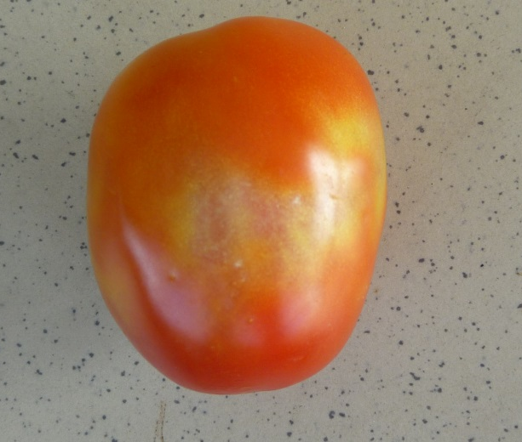
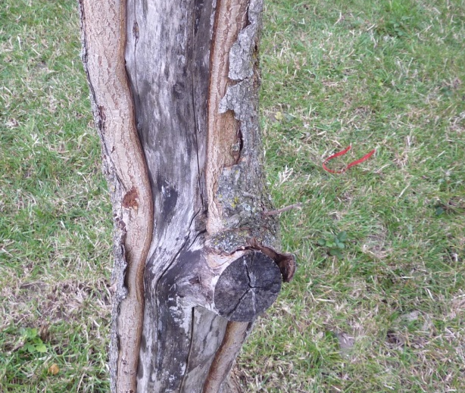
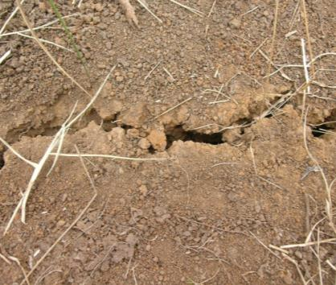
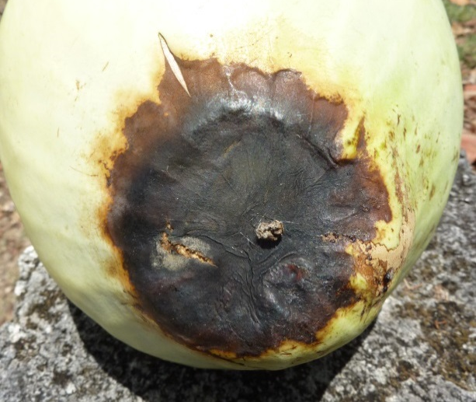
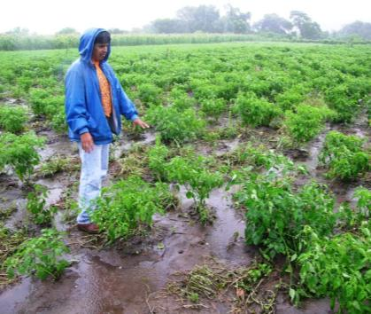
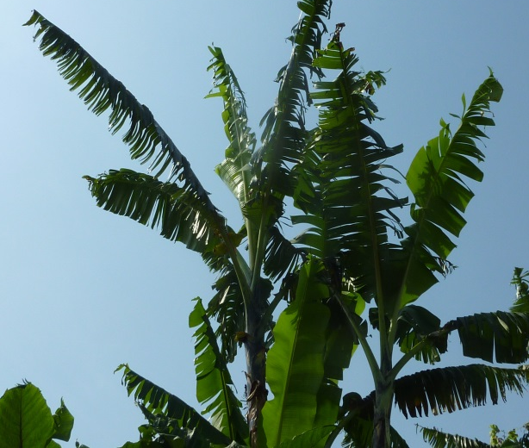
ABIOTIC
OTHER CAUSES
Sun Scald
Physical damage: tools, people
Soil type, structure
Soil fertility
Water: too much /
not enough
Climate: wind, temperature, storms
PLANTWISE TRAINING. MODULE 1: HOW TO BECOME A PLANT DOCTOR. BEING A DETECTIVE: LEARNING MORE ABOUT CAUSES
Notes:
Not all problems are caused by pests. These are the abiotic ones that we will be hearing more about.
DO NOT go through each photo dicussing what is the cause…..

Slide 5
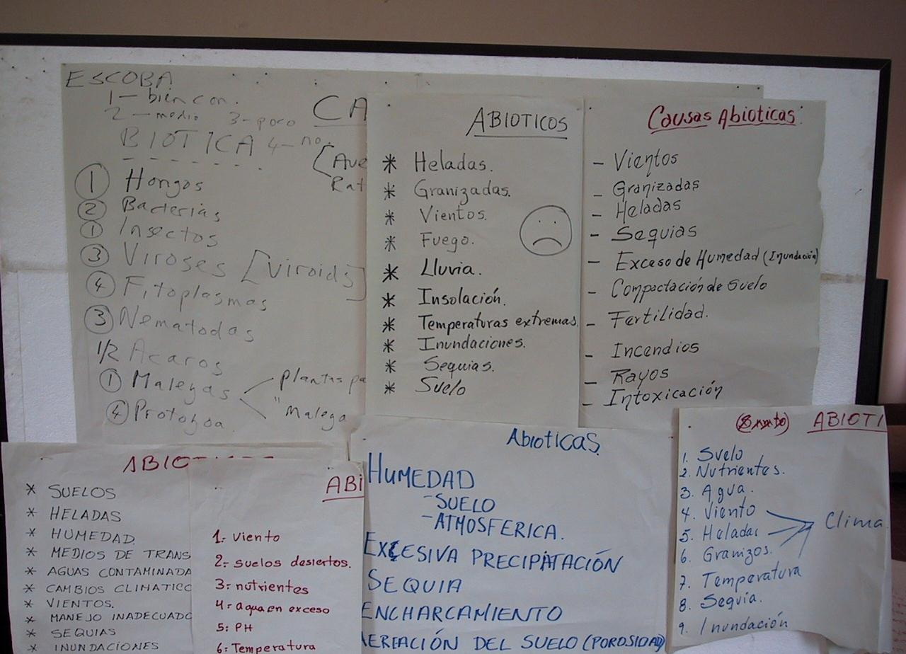
FIELD DIAGNOSIS: A PROCESS OF ELIMINATION
PLANTWISE TRAINING. MODULE 1: HOW TO BECOME A PLANT DOCTOR. BEING A DETECTIVE: LEARNING MORE ABOUT CAUSES
Notes:
Filler slide no need to make any comments.
In the next few slides the trainees are going to be looking at unfamiliar pests (and diseases). Get them to think briefly about the cause (initially abiotic or biotic) and then more detailed consideration.

Slide 6
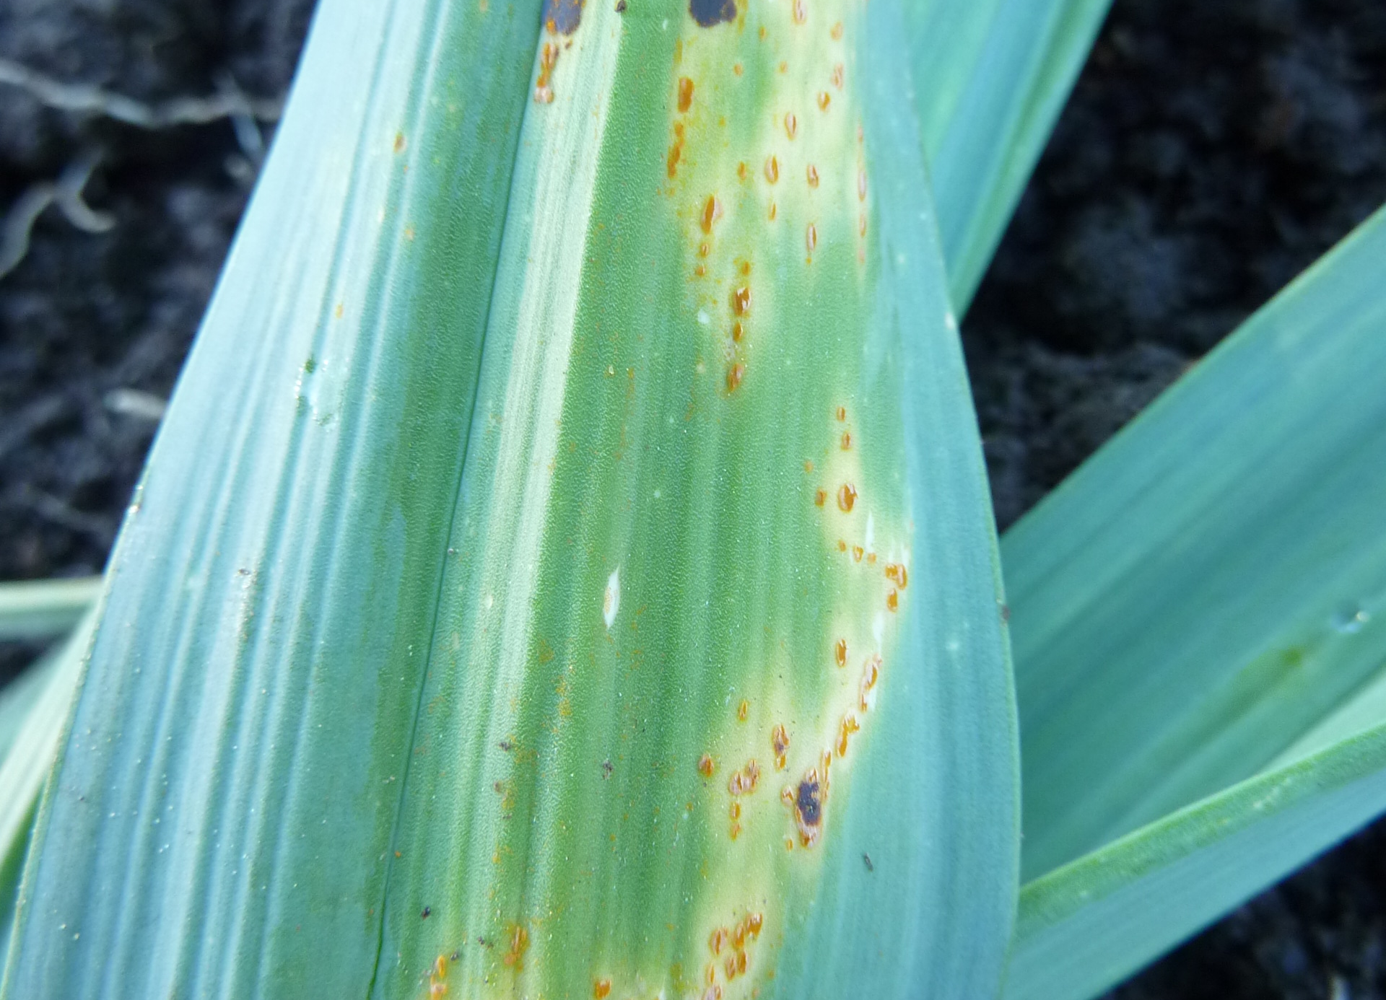
ELIMINATION 1
BIOTIC
BIOTIC
ABIOTIC
Leek
UK
PLANTWISE TRAINING. MODULE 1: HOW TO BECOME A PLANT DOCTOR. BEING A DETECTIVE: LEARNING MORE ABOUT CAUSES
Notes:
Orange spore masses on the underside of a leaf belong to the leaf rust therefore biotic. These orange spore masses are the rust pustules bursting out of the leaf. They should be described as leaf spots on the prescription sheet but that is not important at this point. Everyone should appreciate that this COULD NOT be an abiotic cause.

Slide 7
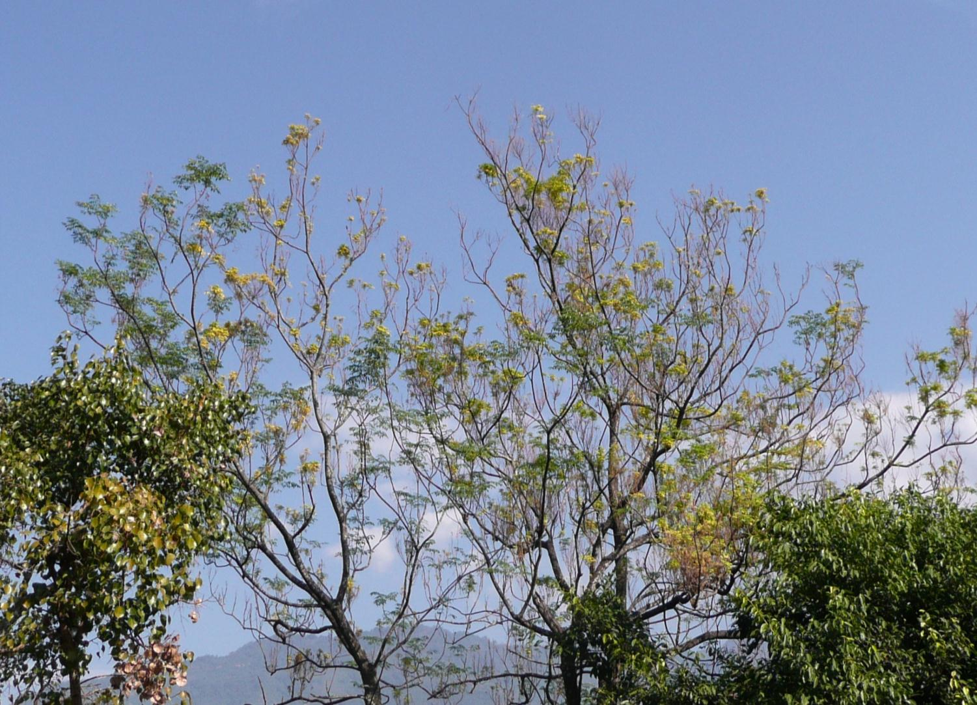
ELIMINATION 2
BIOTIC
BIOTIC
ABIOTIC
Chinaberry, Persian lilac
Nepal
PLANTWISE TRAINING. MODULE 1: HOW TO BECOME A PLANT DOCTOR. BEING A DETECTIVE: LEARNING MORE ABOUT CAUSES
Notes:
Symptoms in tree crowns are difficult to see in this example. The dashed area highlights an area where the leaves are bunching and turning yellow, due to a phytoplasma infection ie. biotic. The area enclosed to the left is green and healthy. Note how both areas are arising from the same bow (circled). They are both in the same environment (light humidity temperature etc) this has to be a biotic cause as both branches share the same root system.
Even though the trainees will not have seen this before they should be able to work out that this disorder has a biotic cause.

Slide 8
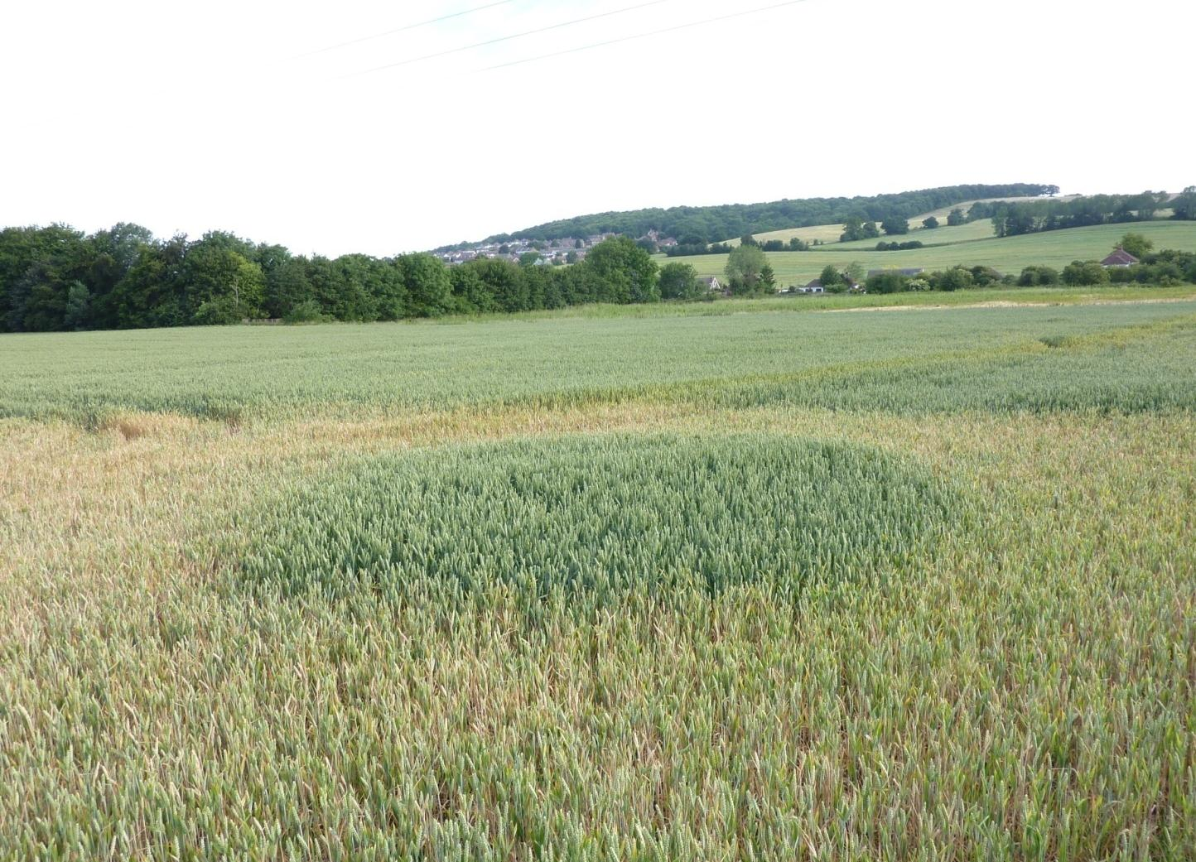
ELIMINATION 3
BIOTIC
ABIOTIC
ABIOTIC
Winter Wheat
UK
PLANTWISE TRAINING. MODULE 1: HOW TO BECOME A PLANT DOCTOR. BEING A DETECTIVE: LEARNING MORE ABOUT CAUSES
Notes:
Note the circular patch of greener wheat in the centre of the image surrounded by yellowing water-stressed plants. Normally (unless there are physical barriers) populations of biotic agents would not leave a distinct circular patch with defined borders, it would have swept through the whole field. This is far more likely to be as a result of an abiotic factor such as a soil condition.

Slide 9
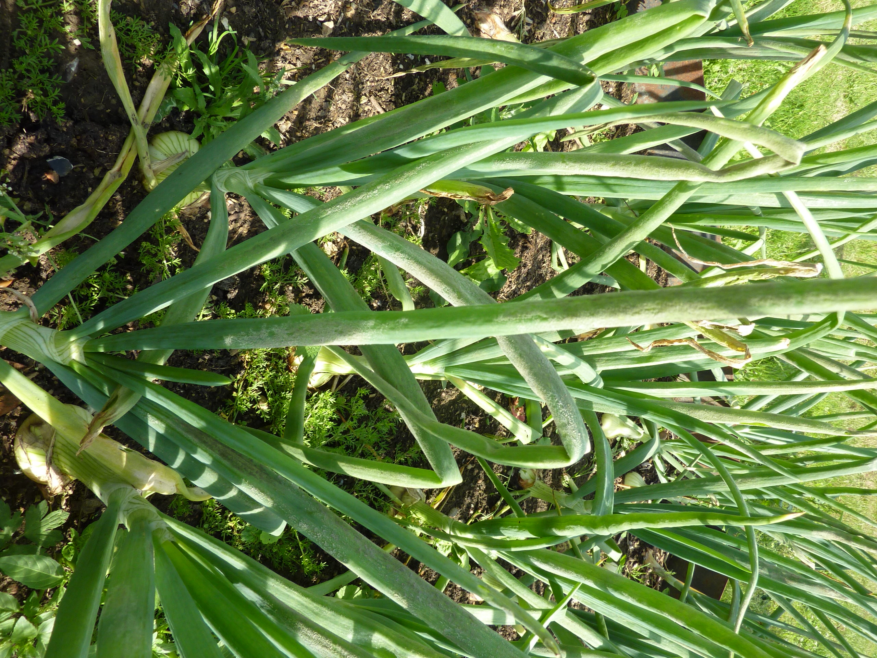
ELIMINATION 4
BIOTIC
BIOTIC
ABIOTIC
Onion
UK
PLANTWISE TRAINING. MODULE 1: HOW TO BECOME A PLANT DOCTOR. BEING A DETECTIVE: LEARNING MORE ABOUT CAUSES
Notes:
Once the trainees have seen the sporulation they should all appreciate that this has a biotic cause. We are not asking what the biotic cause is at this stage.
The onions are affected by downy mildew Peronsopora parasitica. It is not a fungal pathogen it is a water mould. The fluffy growth on the side of the onion leaf is the sporulating water mould. Clearly caused by a microoganism and is therefore biotic.

Slide 10
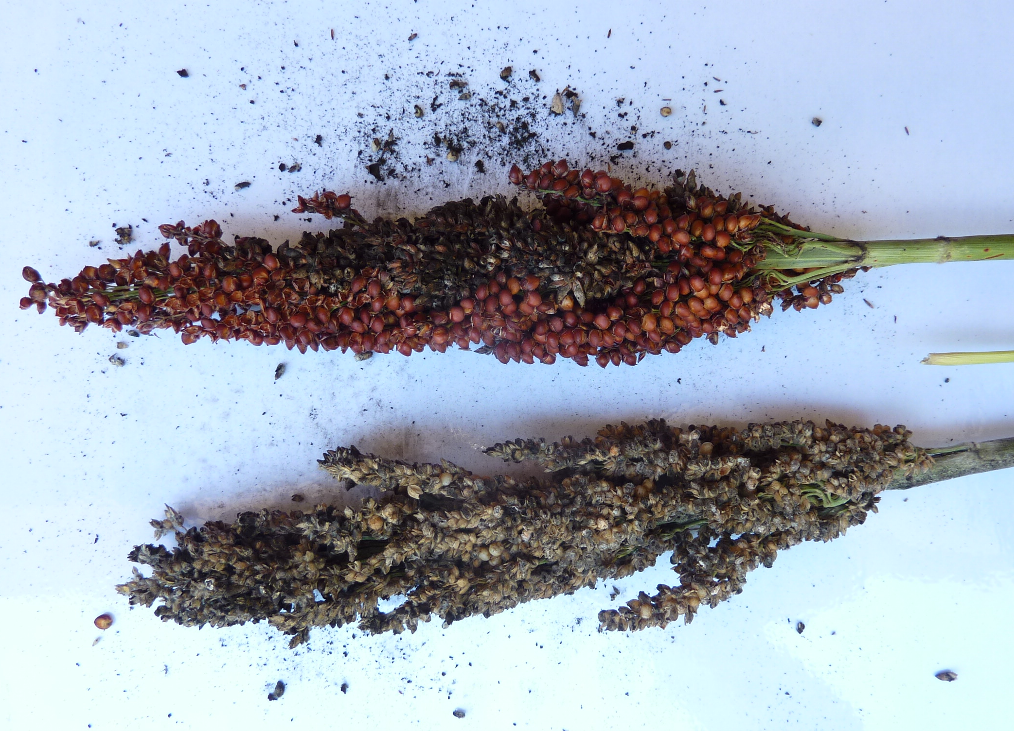
ELIMINATION 5
BIOTIC
BIOTIC
ABIOTIC
Sorghum
Malawi
PLANTWISE TRAINING. MODULE 1: HOW TO BECOME A PLANT DOCTOR. BEING A DETECTIVE: LEARNING MORE ABOUT CAUSES
Notes:
The seeds of the sorghum have been invaded by the fungus and have turned into a black dusty mass (fungal spores). This could not have been caused by an abiotic cause and is clearly caused by a microorganism.

Slide 11
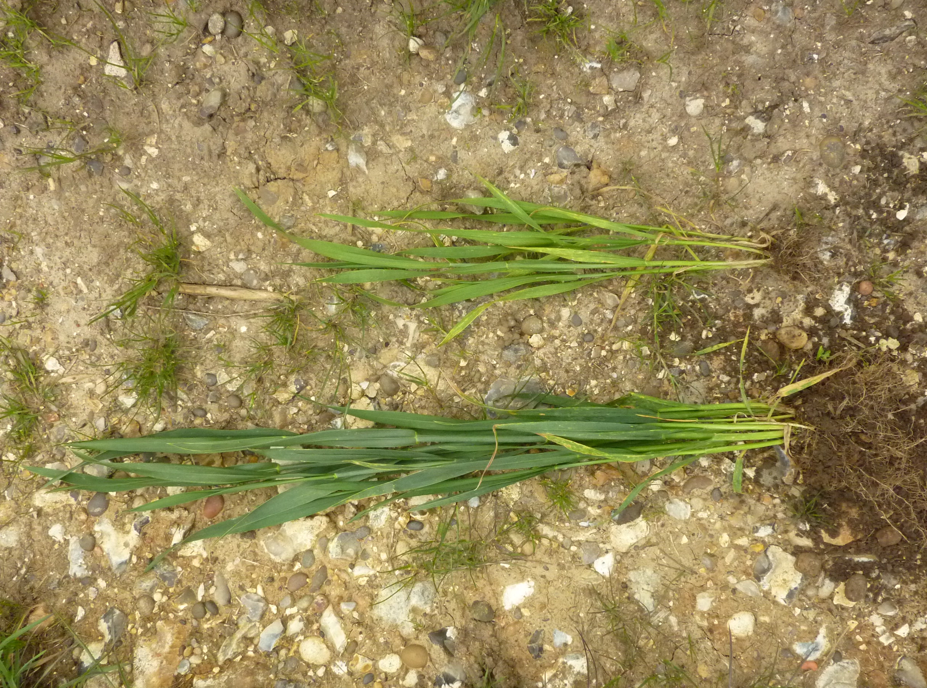
ELIMINATION 6
BIOTIC
ABIOTIC
ABIOTIC
Winter Wheat
UK
PLANTWISE TRAINING. MODULE 1: HOW TO BECOME A PLANT DOCTOR. BEING A DETECTIVE: LEARNING MORE ABOUT CAUSES
Notes:
The general stunting and yellowing of the top plant could be caused by a variety of factors BUT there are no real obvious symptoms other than the small size and yellowing. These symptoms are caused by Manganese deficiency but there is not real way of telling that from this photograph. The trainees should be able to make a reasonable guess that the cause is abiotic though.

Slide 12
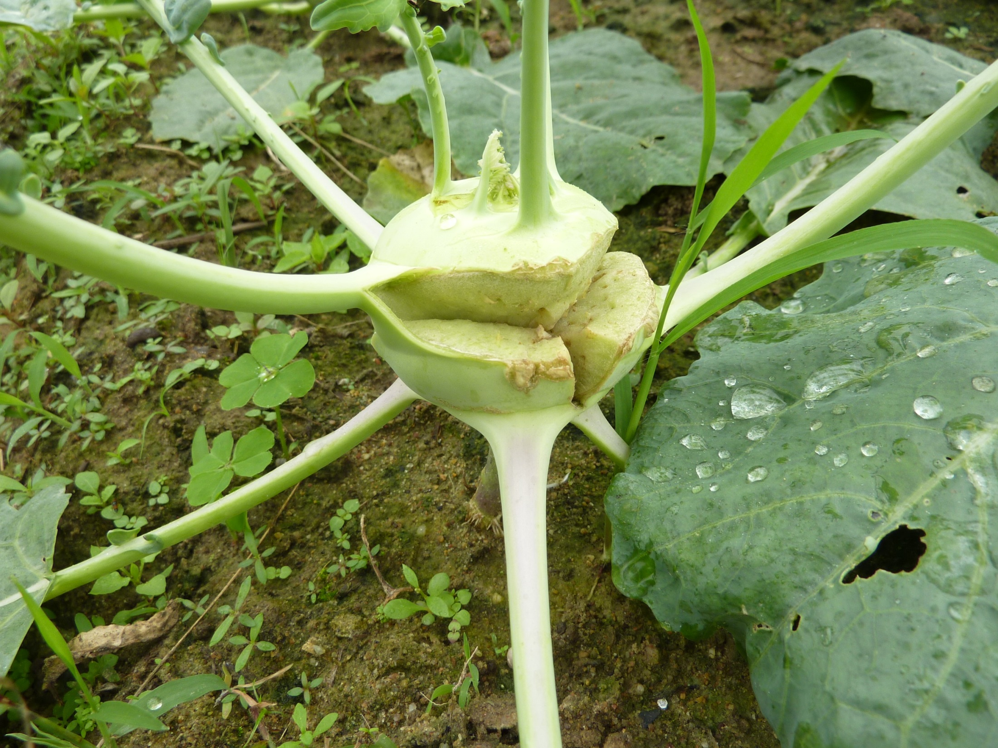
ELIMINATION 7
BIOTIC
ABIOTIC
ABIOTIC
Kohl rabi
Vietnam
PLANTWISE TRAINING. MODULE 1: HOW TO BECOME A PLANT DOCTOR. BEING A DETECTIVE: LEARNING MORE ABOUT CAUSES
Notes:
In all these slides let there be a small amount of discussion before bringing in the answer. Remember we are not asking for the cause just whether or not it abiotic or biotic.
This kohl rabi plant has split but there does not appear to be any rotting or microorganism associated with the tear. This has almost certainly split due to irregular watering whereby the inside of the stem was taking up water and swelling faster than the outside could expand and a split occurred. This water stress and so is considered an abiotic cause.

Slide 13
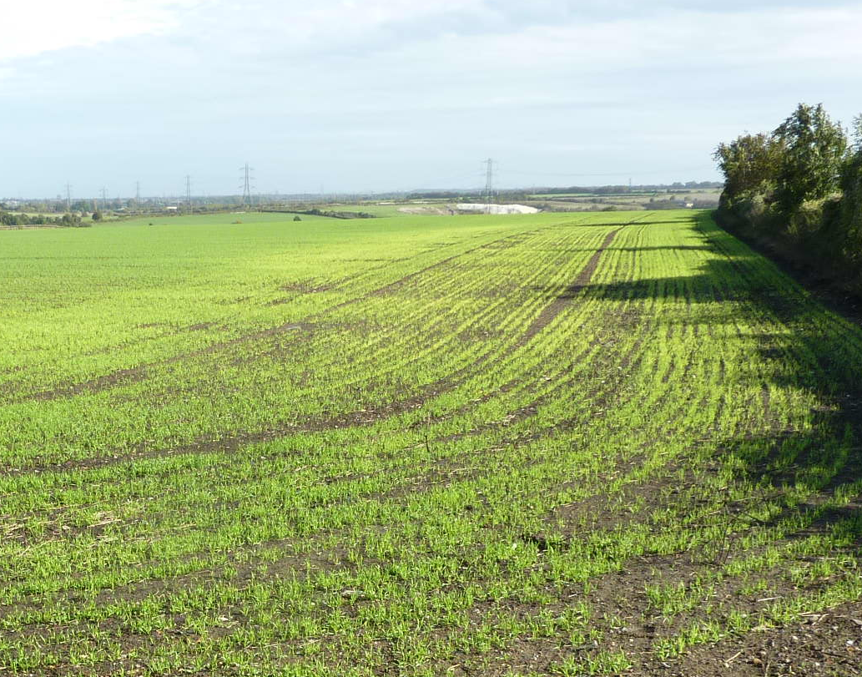
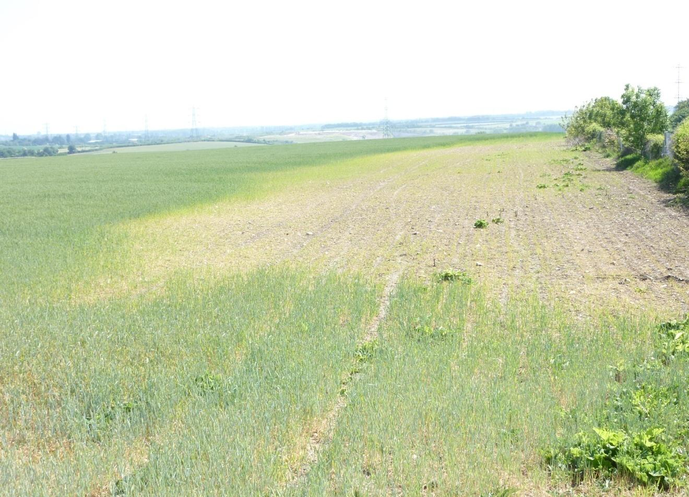
ELIMINATION 8
BIOTIC
ABIOTIC
ABIOTIC
Winter Wheat
UK
PLANTWISE TRAINING. MODULE 1: HOW TO BECOME A PLANT DOCTOR. BEING A DETECTIVE: LEARNING MORE ABOUT CAUSES
Notes:
This is the most difficult one of this set of photos. Look out for the animation of this slide, become familiar with it or you will be caught out when presenting. The former shows the crop beginning to yellow and in the second one the area is dead. You would be forgiven for thinking this was a biotic factor such as rabbits feeding from the margins (not unlike the slide in the previous presentation). Talking to the farmer it was discovered that this was a site of heavy meatal contamination, therefore the problem is abiotic. Notice how the margins of the area have gone yellow and are stunted. Rabbits do not stunt plants or make them go yellow. You would never know this from studying the photos.

Slide 14
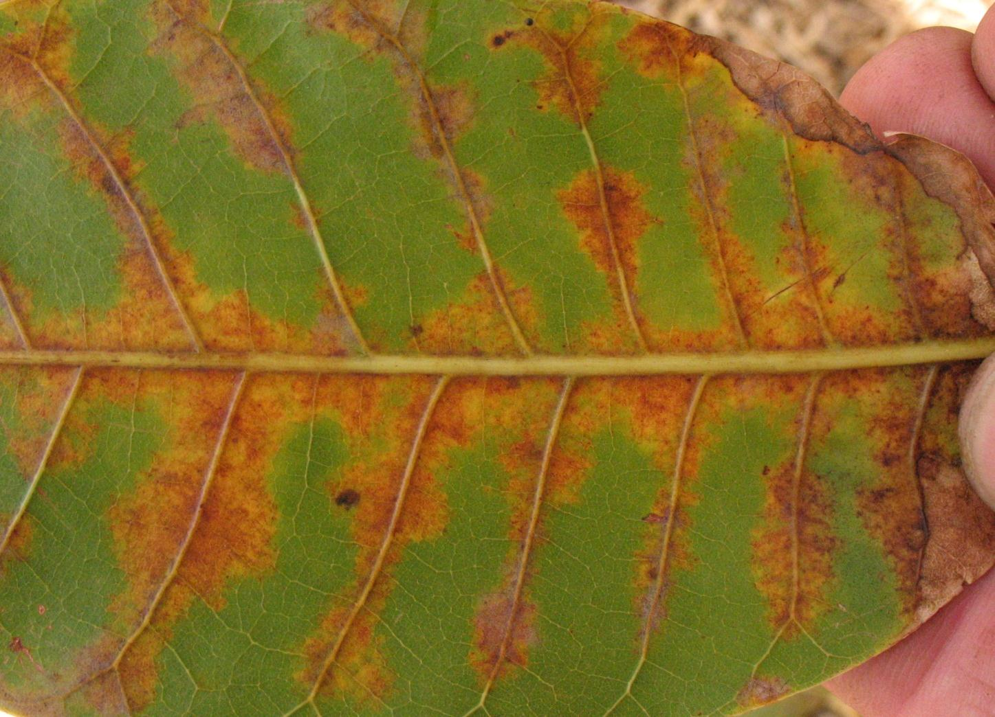
ELIMINATION 9
BIOTIC
?
ABIOTIC
Cashew
Nicaragua
PLANTWISE TRAINING. MODULE 1: HOW TO BECOME A PLANT DOCTOR. BEING A DETECTIVE: LEARNING MORE ABOUT CAUSES
Notes:
This slide is to make the point that if you don’t know then you can be stuck sometimes. Eric Boa took this picture and he is an experienced plant pathologist and he was unsure of what was causing the symptoms.
It is difficult to tell from this picture what is causing these leaf symptoms it could be biotic or abiotic. Ask the group if they have seen anything like it before.

Slide 15
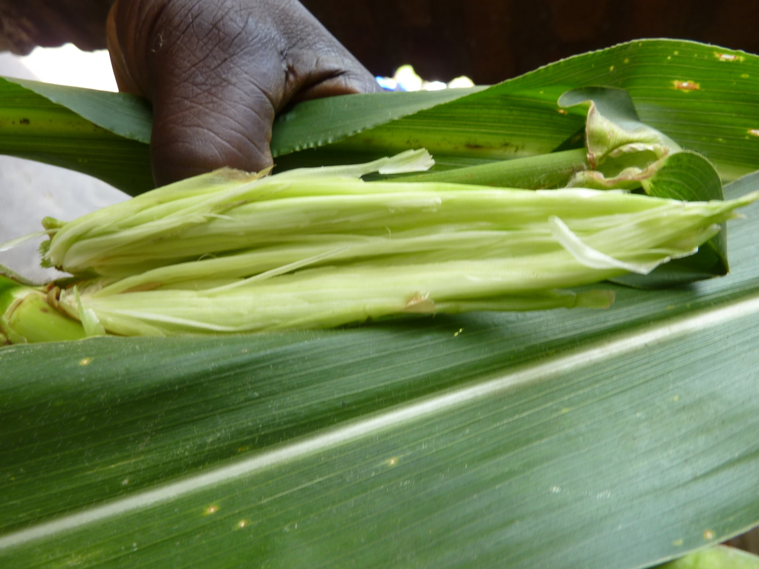
ELIMINATION 10
BIOTIC
?
ABIOTIC
Maize
Malawi
PLANTWISE TRAINING. MODULE 1: HOW TO BECOME A PLANT DOCTOR. BEING A DETECTIVE: LEARNING MORE ABOUT CAUSES
Notes:
Another example where it was difficult to tell if the cause was biotic or abiotic. The plants seem perfectly healthy but when the bracts were unwrapped from around the cob there was no cob present. It is difficult to imagine what was causing this problem.

Slide 16
FIELD DIAGNOSIS 1
NOT INSECT or MITE
No holes or other evidence eg webbing
BIOTIC: Active disease process,
clear border between healthy and diseased area
NOT NEMATODE
Don’t cause this type of symptom
NOT VIRUS
Don’t cause this type of symptom
NOT PHYTOPLASMA
Don’t cause this type of symptom
? BACTERIUM
Unlikely – expect wilt
NOT ANIMAL or BIRD
No feeding damage
? FUNGUS OR WATER MOULD
Possible – known to produce necrosis
NOT LACK OF NUTRIENT
Doesn’t cause this type of symptom
NOT PHY’CAL or HERB’IDE
Doesn’t cause this type of symptom
ELIMINATE THE NEGATIVE
PLANTWISE TRAINING. MODULE 1: HOW TO BECOME A PLANT DOCTOR. BEING A DETECTIVE: LEARNING MORE ABOUT CAUSES
Notes:
This is a key approach to making a diagnosis. The process involves eliminating potential causes based on the observed symptoms, narrowing down the potential causes. In this example a fungus is the most likely cause but there could be a water mould producing the symptoms. It is not possible to tell from this picture. Take the trainees through the process not too slowly dwelling on each finger but with enough time for each one to be read.

Slide 17
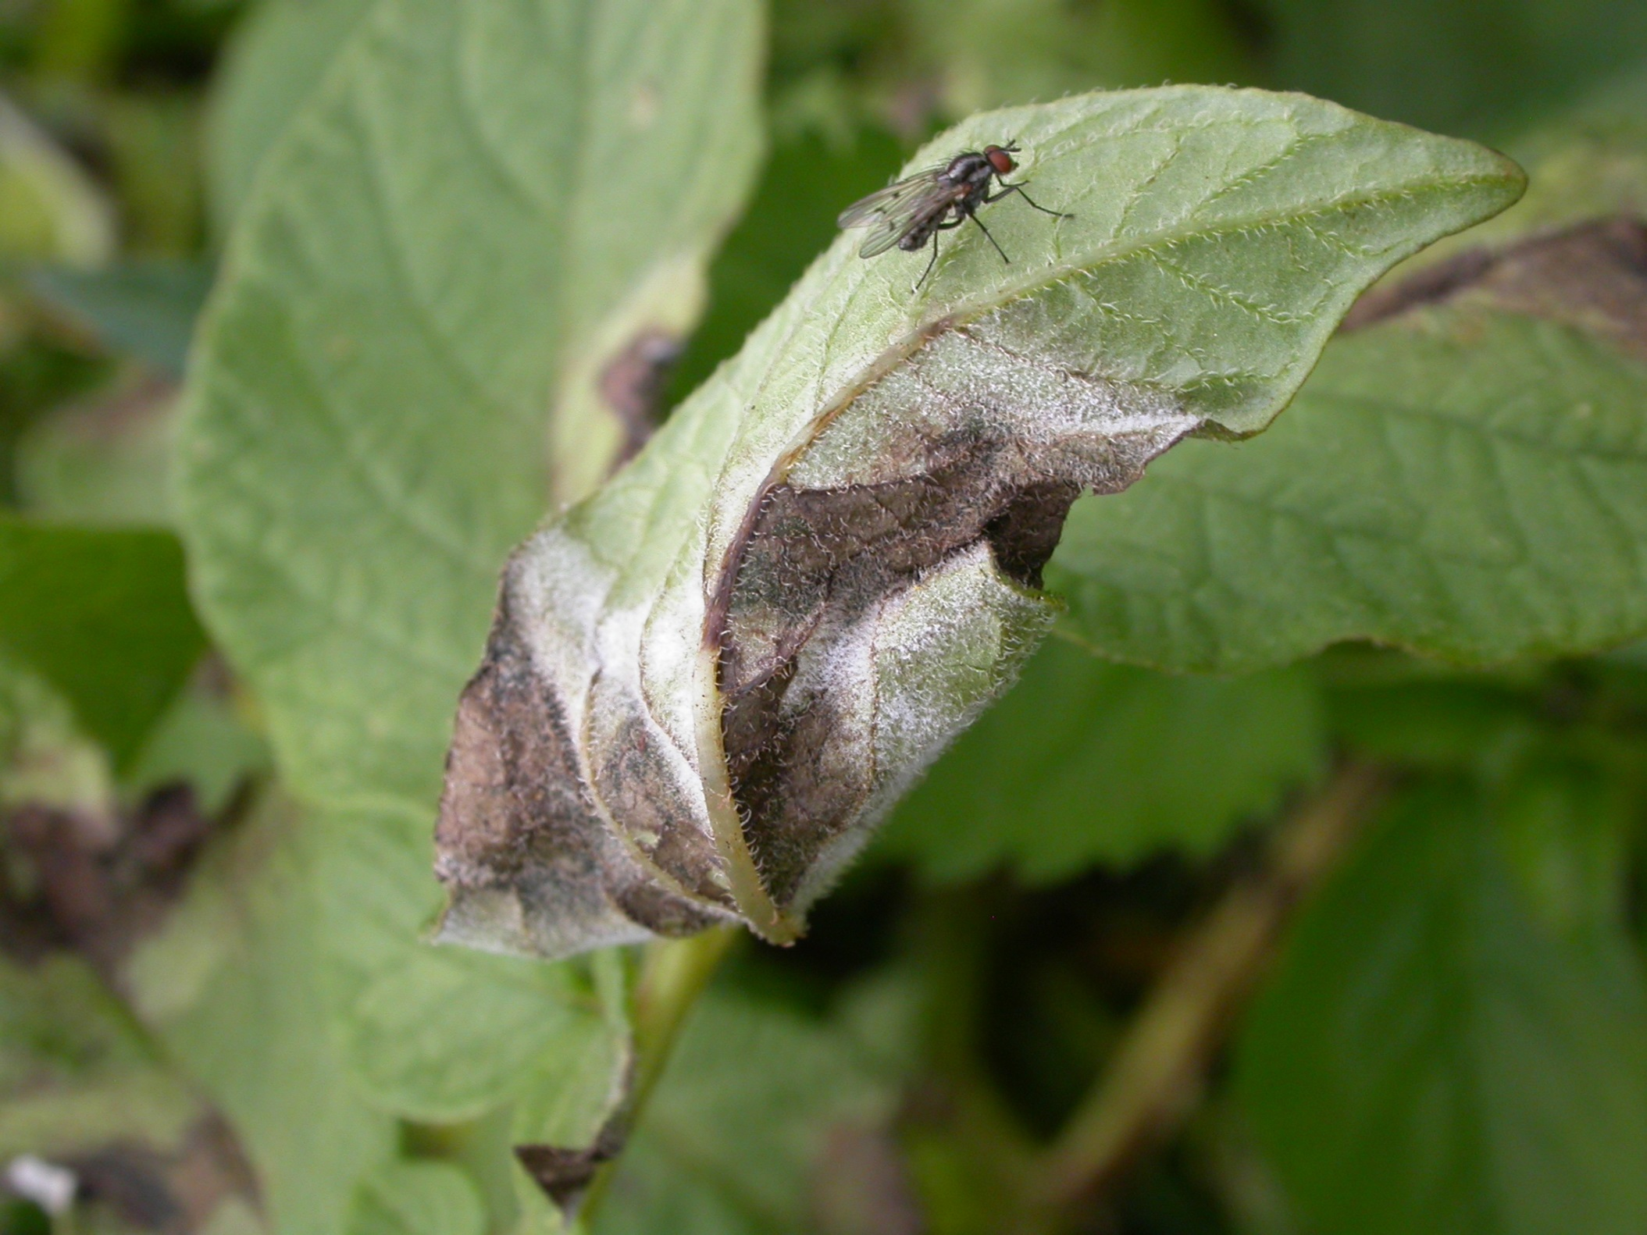
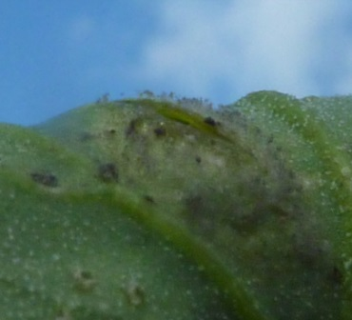
FIELD DIAGNOSIS 2
NOT INSECT or MITE
No holes or other evidence eg webbing
BIOTIC: Active disease process,
clear border between healthy and diseased area
NOT NEMATODE
Don’t cause this type of symptom
? BACTERIUM
Produces leaf spots but not sporulation
NOT VIRUS
Don’t cause this type of symptom
NOT PHYTOPLASMA
Don’t cause this type of symptom
NOT ANIMAL or BIRD
No feeding damage
?FUNGUS
Possible – but wrong kind of sporulation
NOT LACK OF NUTRIENT
Doesn’t cause this type of symptom
?WATER MOULD
Yes! correct sporulation and leaf spots
NOT PHY’CAL or HERB’IDE
Doesn’t cause this type of symptom
ELIMINATE THE NEGATIVE
PLANTWISE TRAINING. MODULE 1: HOW TO BECOME A PLANT DOCTOR. BEING A DETECTIVE: LEARNING MORE ABOUT CAUSES
Notes:
This is a picture of Phytophthora infestans infection on potato. The black area is the necrotic dead area and the white zone is the sporulation of the water mould around the edges. Water moulds (Phytophthora and the DOWNY mildews) frequently sporulate in areas of high humidity. The sporangiophores (these are the little stalks that hold up the sporangia) can be seen as white or pinky fluff on the UNDERSIDE of the leaves.
There is no need and you should not go into details other than to say that there is white fluffy material produced around the area of dead leaf.
Bring the fingers in one at a time do not dwell on each one for long. Use the animation on this slide to bring in the hand lens.

Slide 18
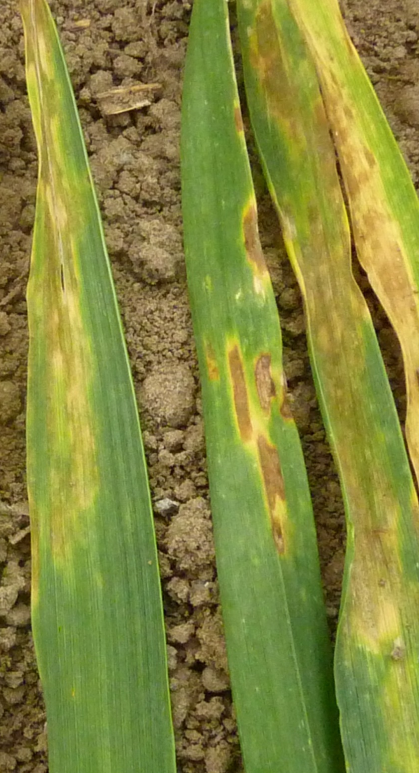
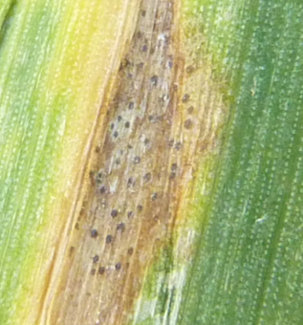
FIELD DIAGNOSIS 3
NOT INSECT or MITE
No holes or other evidence eg webbing
BIOTIC: Active disease process,
clear border between healthy and diseased area
NOT NEMATODE
Don’t cause this type of symptom
NOT VIRUS
Don’t cause this type of symptom
NOT PHYTOPLASMA
Don’t cause this type of symptom
? BACTERIUM OR WATER MOULD Look for fruiting bodies
NOT ANIMAL or BIRD
No feeding damage
FUNGUS !
Small black dots: fruiting bodies found!
Known to produce these symptoms
NOT LACK OF NUTRIENT
Doesn’t cause this type of symptom
NOT PHY’CAL or HERB’IDE
Doesn’t cause this type of symptom
ELIMINATE THE NEGATIVE
PLANTWISE TRAINING. MODULE 1: HOW TO BECOME A PLANT DOCTOR. BEING A DETECTIVE: LEARNING MORE ABOUT CAUSES
Notes:
This is Septoria on wheat. The necrotic brown zone are surrounded by a yellow border. This is typical of this kind of leaf spot. The presence of fungal fruiting bodies within the lesion makes the fungal cause a certainty. If the fruiting bodies could not be found then this does not mean that it is not a fungus that is responsible.
Use the animation on this slide to bring in the hand lens.

Slide 19
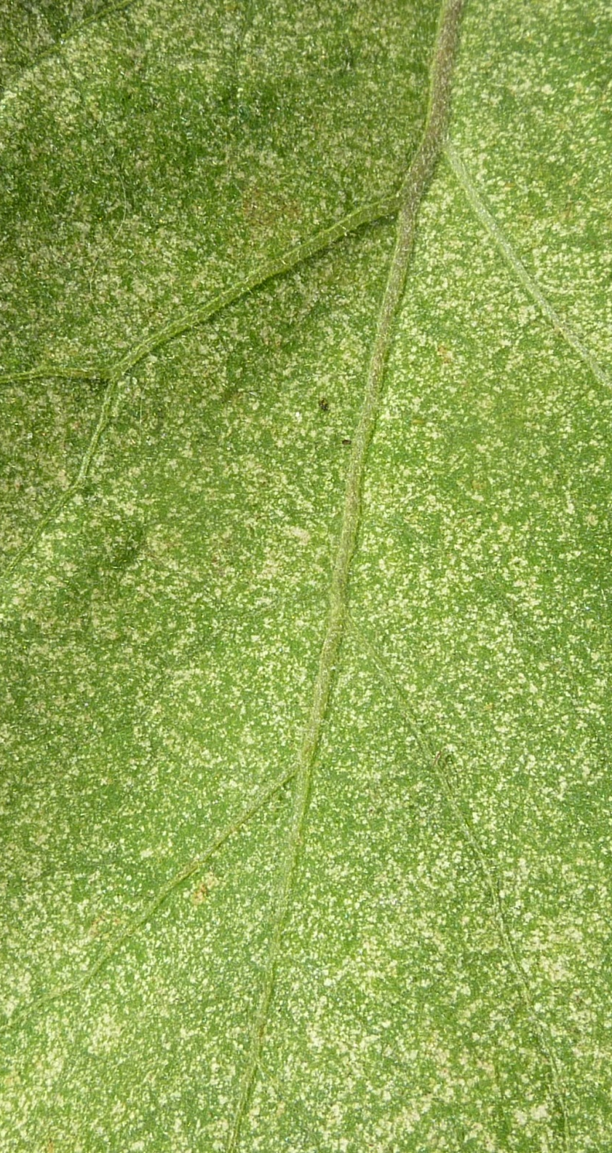
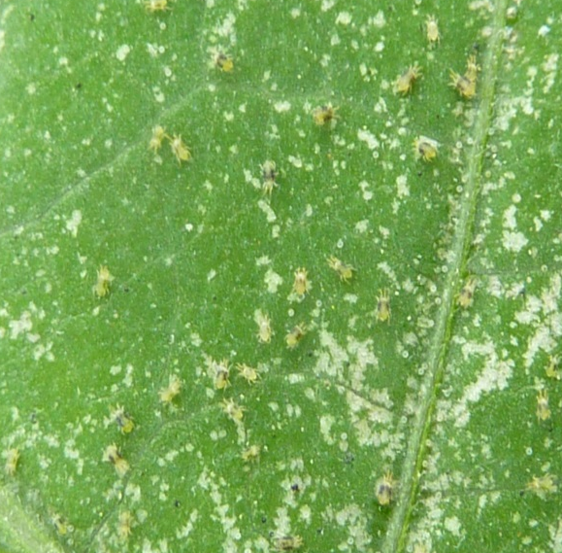
FIELD DIAGNOSIS 4
?VIRUS
Mosaic appears too small
NOT FUNGUS or BACTERIA
Don’t cause this type of symptom
INSECT or MITE ?
NOT NEMATODE
Don’t cause this type of symptom
NOT VIRUS
Don’t cause this type of symptom
NOT PHYTOPLASMA
Don’t cause this type of symptom
NOT ANIMAL or BIRD
No feeding damage
NOT LACK OF NUTRIENT
Doesn’t cause this type of symptom
MITES ! Use a handlens
NOT PHY’CAL or HERB’IDE
Doesn’t cause this type of symptom
ELIMINATE THE NEGATIVE
PLANTWISE TRAINING. MODULE 1: HOW TO BECOME A PLANT DOCTOR. BEING A DETECTIVE: LEARNING MORE ABOUT CAUSES
Notes:
The speckled leaf could be considered a mosaic BUT the markings are superfical. This symptom is typical of small grazing insects or mites that are only feeding on the surface of the leaf. Realistically it could only be thrips or mites. Using a hand lens showed it be mites.
Use the animation on this slide to bring in the hand lens.

Slide 20
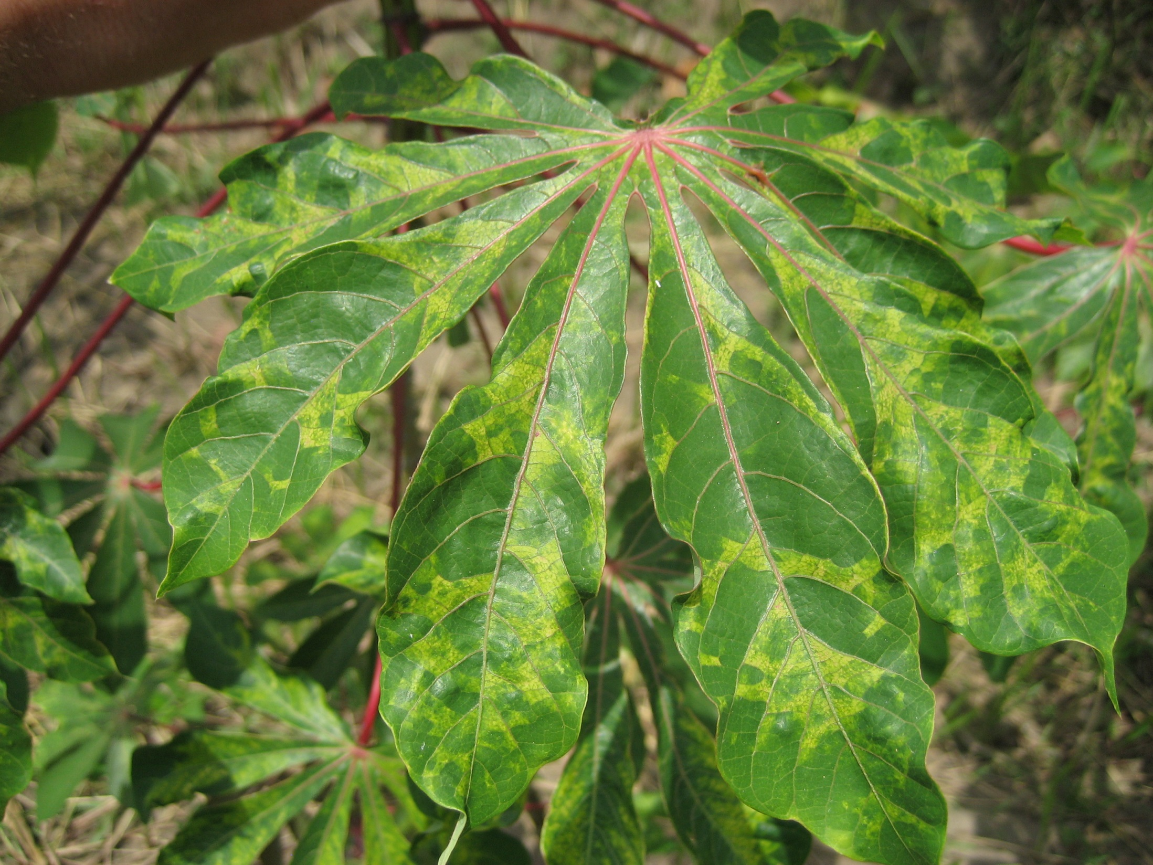
ELIMINATION 11
FUNGUS
WATER MOULD
BACTERIA
VIRUS
VIRUS
PHYTOPLASMA
NEMATODE
INSECT
MITES
ANIMALS & BIRDS
NUTRIENTS
PHY’CAL & HERB’IDE
Cassava (Uganda)
PLANTWISE TRAINING. MODULE 1: HOW TO BECOME A PLANT DOCTOR. BEING A DETECTIVE: LEARNING MORE ABOUT CAUSES
Notes:
The trainees have had a little taster of what is diagnosis by elimination is at this point and they are now invited to have a go on some other photos. DO NOT keep them guessing as to what the cause might be move through these slides quite quickly some of them they should be familiar with whereas for others it is unlikely that they will have come across the complaint.
Mosaic and distortion this slide screams VIRUS at you. This is Cassava Mosaic virus on cassava. A very common disease in much of Africa. Notice how the symptoms are not symmetrical around the midrib of the leaf, this is a strong indicator that the problem is not one of soil fertility.

Slide 21
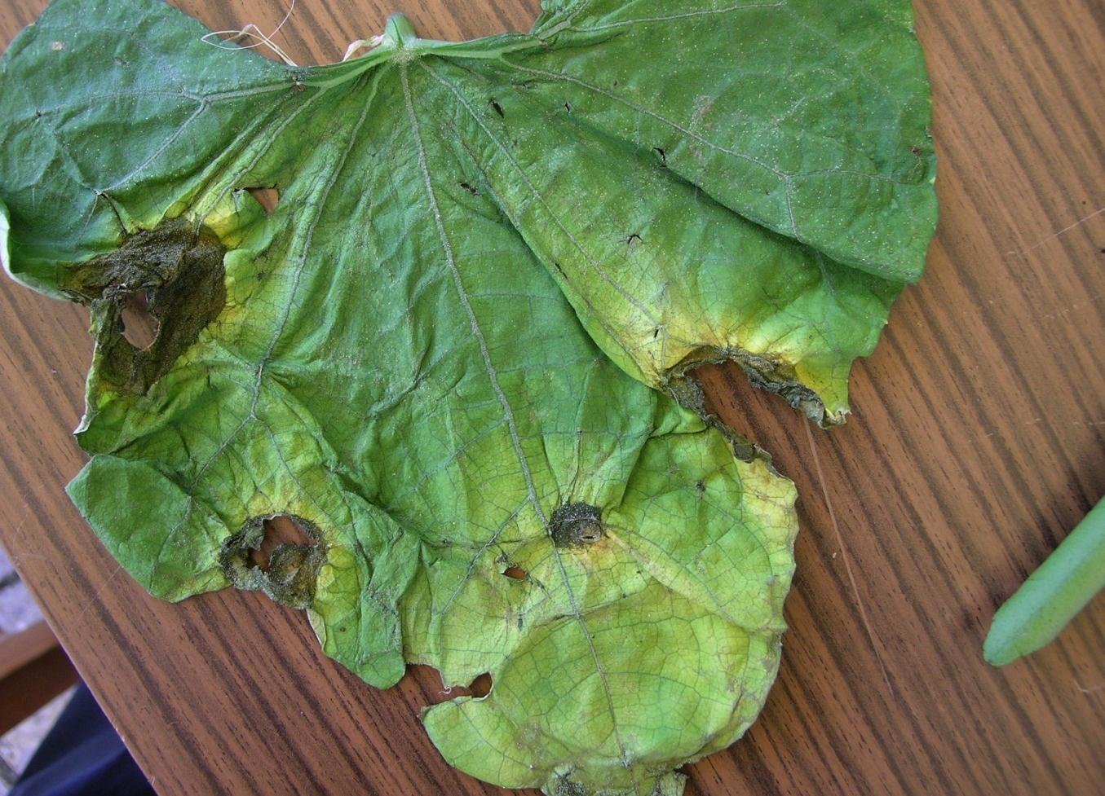
FUNGUS
ELIMINATION 6
FUNGUS
ELIMINATION 12
WATER MOULD
WATER MOULD
BACTERIA
BACTERIA
VIRUS
PHYTOPLASMA
NEMATODE
INSECT
MITES
ANIMALS & BIRDS
NUTRIENTS
PHY’CAL & HERB’IDE
Cucumber
Nicaragua
PLANTWISE TRAINING. MODULE 1: HOW TO BECOME A PLANT DOCTOR. BEING A DETECTIVE: LEARNING MORE ABOUT CAUSES
Notes:
This plant is wilted but that is not the issue here. The wilt was caused by the delay in taking the leaf to the plant clinic. The symptoms that the trainees should home in on are the necrotic regions with the yellow borders. What could be causing these? They could be fungal or bacterial (or water mould except I am not aware of a water mould that could cause this type of symptoms on cucurbits).
Which is it? Three of the four areas are beginning from the edge of the leaf which indicates a bacterial cause but there is no real evidence that they are being limited by the leaf veins which would indicate fungal. It is not really possible to tell the cause based on this photograph.

Slide 22
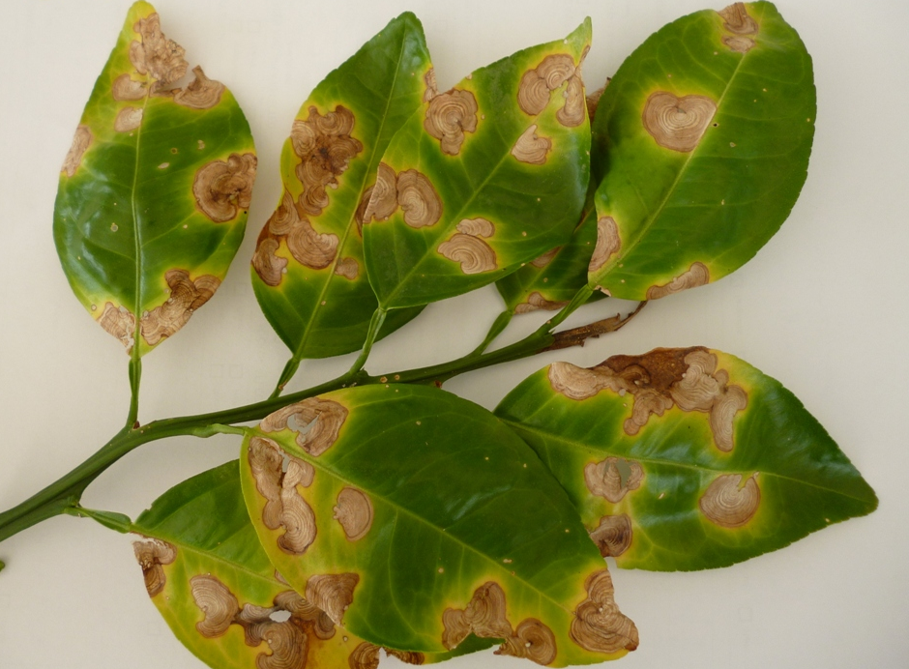
FUNGUS
ELIMINATION 13
FUNGUS
WATER MOULD
BACTERIA
VIRUS
PHYTOPLASMA
NEMATODE
INSECT
MITES
ANIMALS & BIRDS
NUTRIENTS
PHY’CAL & HERB’IDE
Citrus
Grenada[S Rambadan]
PLANTWISE TRAINING. MODULE 1: HOW TO BECOME A PLANT DOCTOR. BEING A DETECTIVE: LEARNING MORE ABOUT CAUSES
Notes:
The internal markings within the lesions indicate a fungal cause. Water moulds or bacteria do not generally produce any internal patterns or structures with the lesions. Move through these slide quite quickly, there are a lot of them.

Slide 23
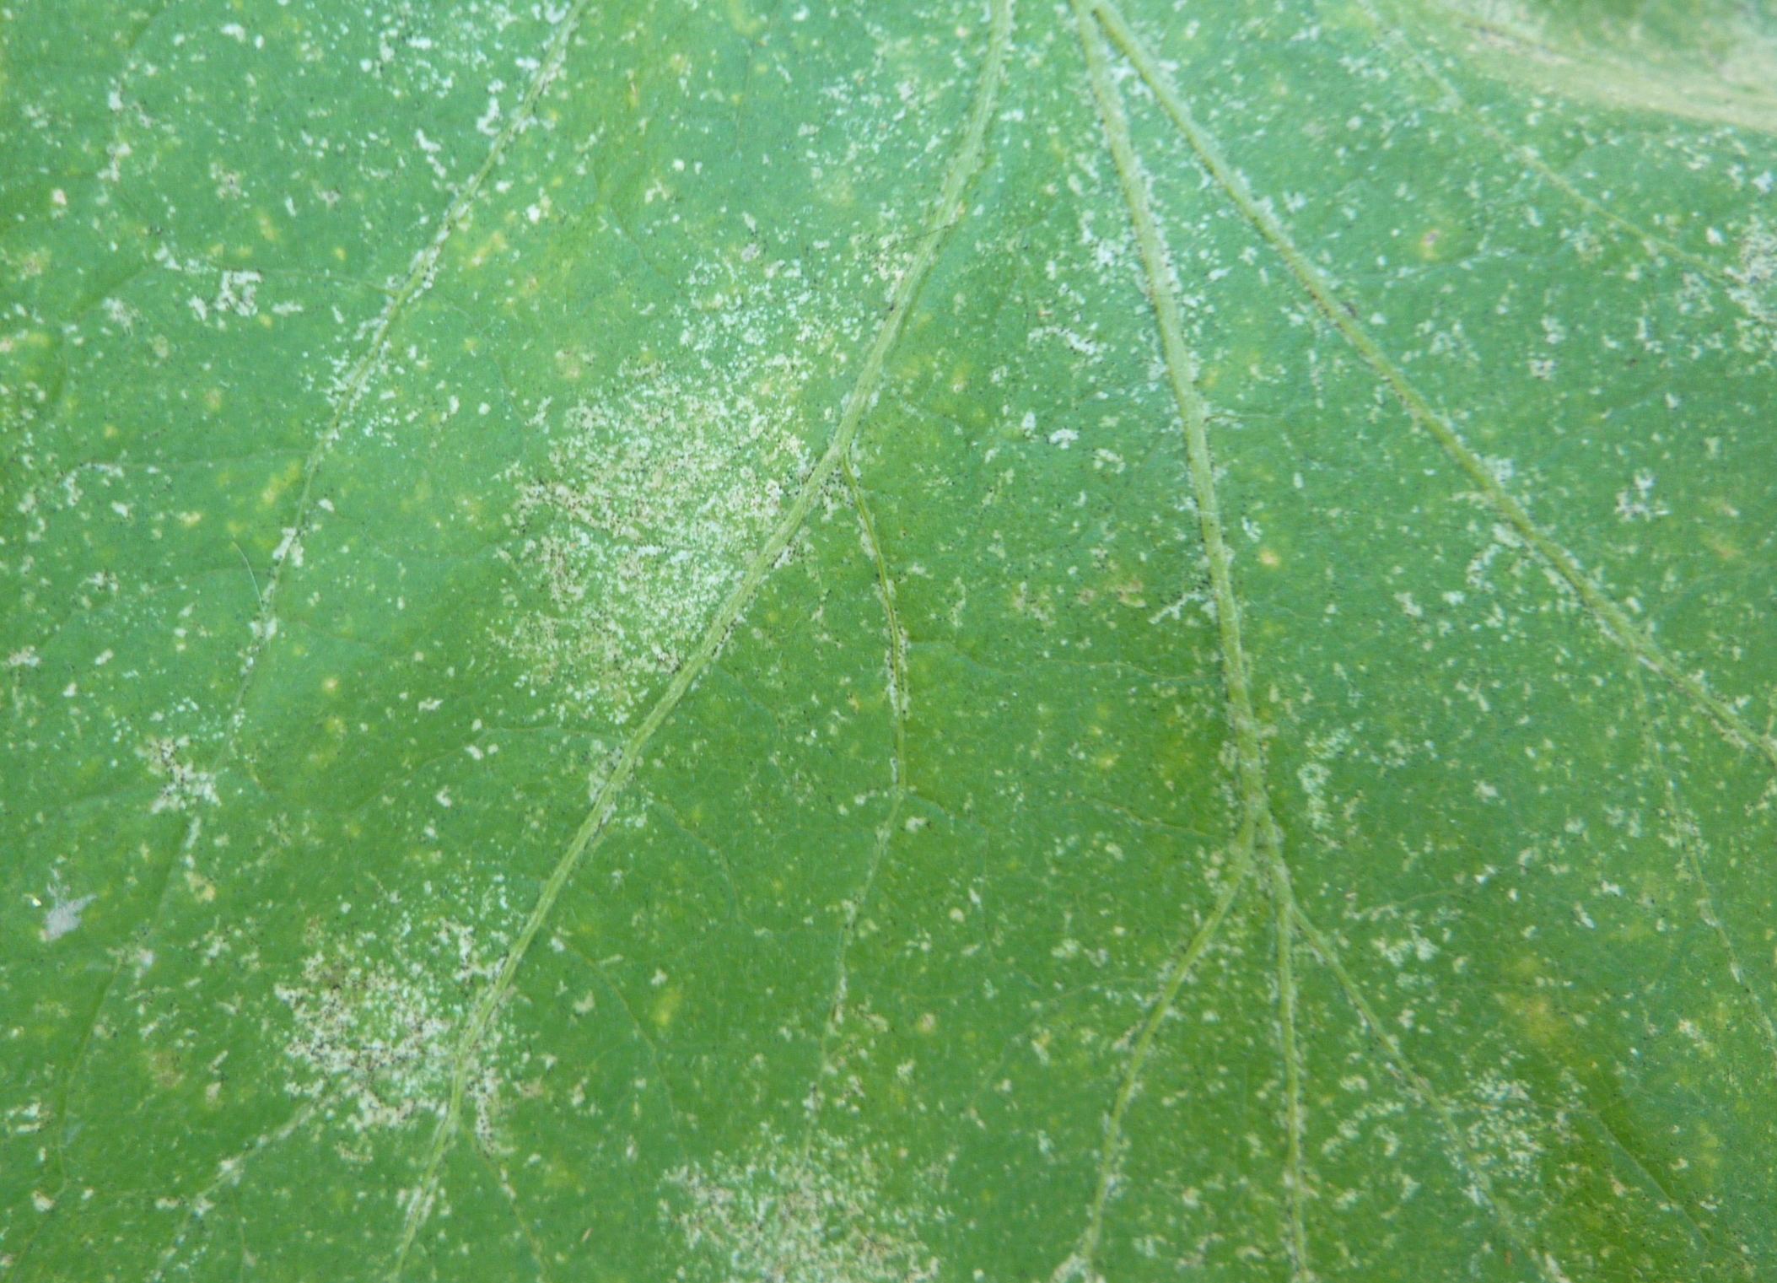
ELIMINATION 14
FUNGUS
WATER MOULD
BACTERIA
VIRUS
PHYTOPLASMA
NEMATODE
INSECT
INSECT
MITES
MITES
ANIMALS & BIRDS
NUTRIENTS
PHY’CAL & HERB’IDE
Eggplant
Vietnam
PLANTWISE TRAINING. MODULE 1: HOW TO BECOME A PLANT DOCTOR. BEING A DETECTIVE: LEARNING MORE ABOUT CAUSES
Notes:
As for 4 slides previously the superficial speckling on the surface of the leaf is almost certainly due to the feeding of very small insects or mites. The small black dots on the leaf surface indicate that this is thrips feeding (the small black dots are the frass they produce) but you would not expect the trainees to know this.

Slide 24
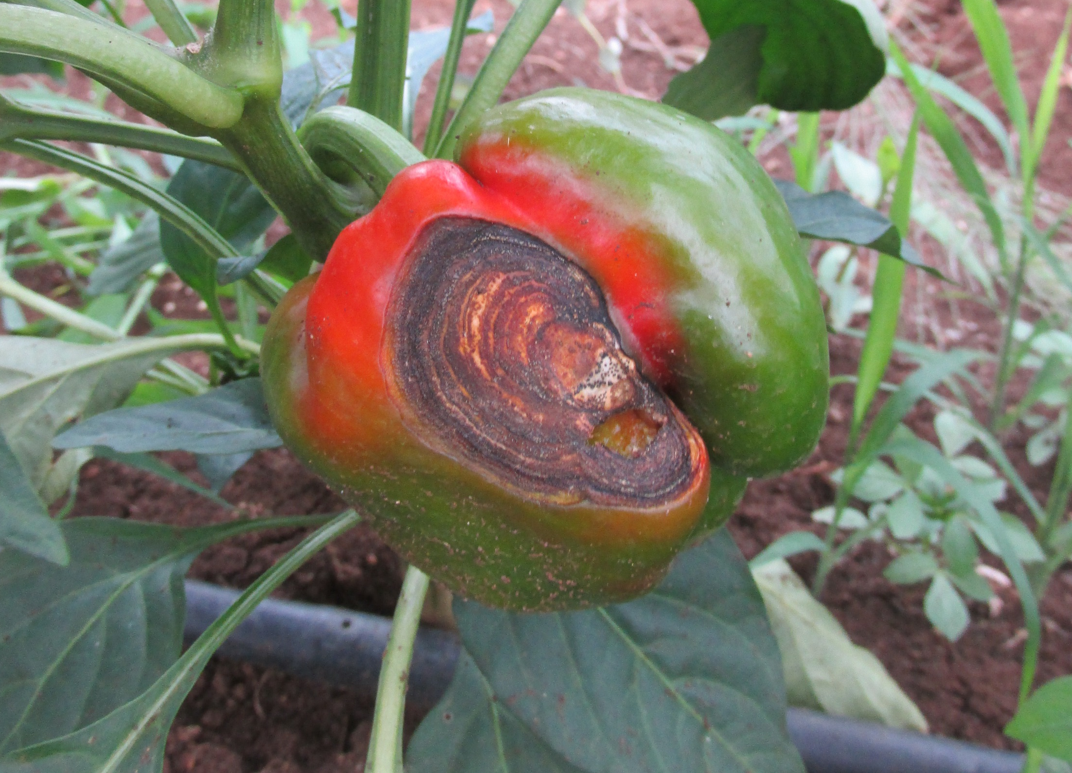
FUNGUS
ELIMINATION 7
FUNGUS
ELIMINATION 6
ELIMINATION 6
ELIMINATION 15
WATER MOULD
BACTERIA
VIRUS
PHYTOPLASMA
NEMATODE
INSECT
MITES
ANIMALS & BIRDS
NUTRIENTS
PHY’CAL & HERB’IDE
Capsicum
Grenada [T Peters]
PLANTWISE TRAINING. MODULE 1: HOW TO BECOME A PLANT DOCTOR. BEING A DETECTIVE: LEARNING MORE ABOUT CAUSES
Notes:
This may seem a bit daunting if you have never seen it before but with a bit of experience it is quite obviously a fungal lesion. This is the same photot as we seen in presentation “Causes of plant health problems”. The rings within the lesion are actually rings of fruiting bodies, either the rings by themselves or the presence of the fungal fruiting bodies would be enough to clearly identify this as a fungal lesion.
This is Colletotrichum and is quite characteristic once you have seen it a few times.

Slide 25
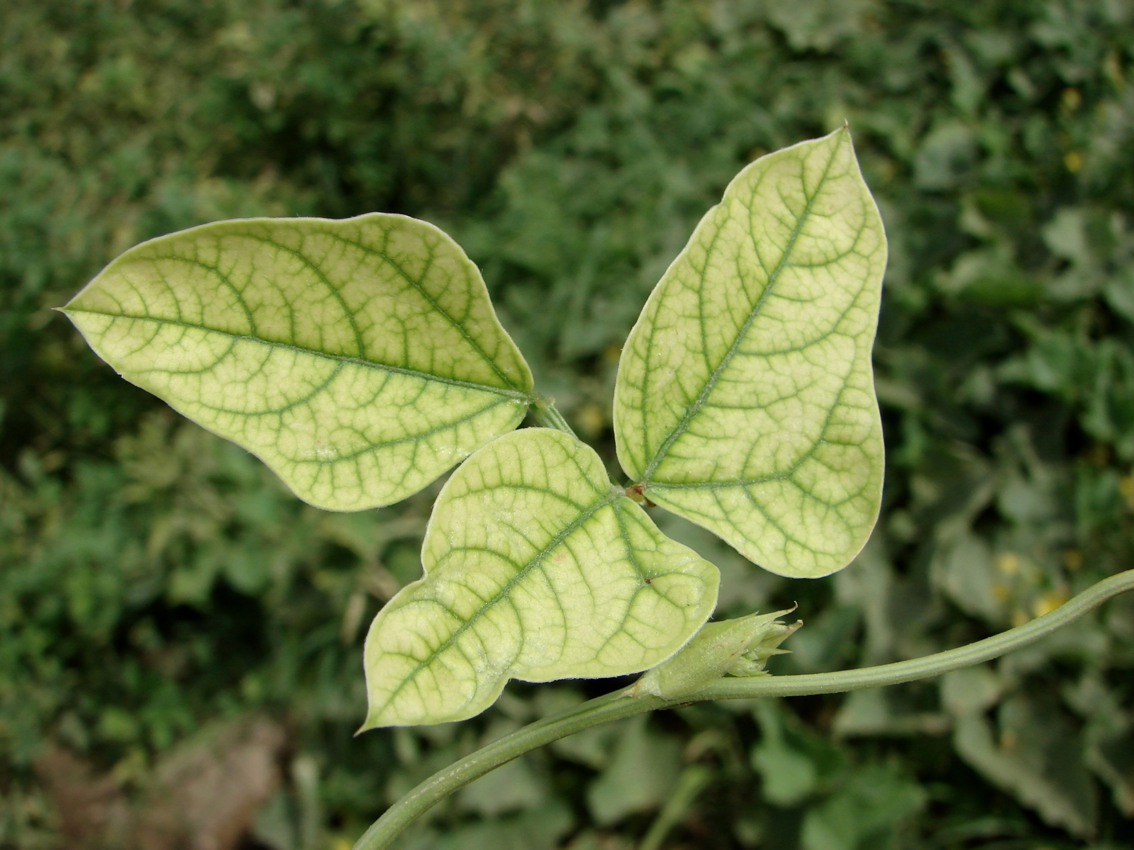
ELIMINATION 7
FUNGUS
ELIMINATION 6
ELIMINATION 6
ELIMINATION 16
WATER MOULD
BACTERIA
VIRUS
PHYTOPLASMA
NEMATODE
INSECT
MITES
ANIMALS & BIRDS
NUTRIENTS
NUTRIENTS
PHY’CAL & HERB’IDE
Cowpea
India [P Kumar and M Sharma]
PLANTWISE TRAINING. MODULE 1: HOW TO BECOME A PLANT DOCTOR. BEING A DETECTIVE: LEARNING MORE ABOUT CAUSES
Notes:
The symmetry of the symptoms on the leaf and the absence of any other symptoms (the leaf does not appear distressed in any way other than it has lost the green colour between the veins) strongly indicates that this is caused by a lack of nutrients. The symptoms are a classic sign of iron deficiency. There are presentations coming up on the symptoms of nutrient deficiency and they will have the diagnostic field guide to assist them too so don’t let the trainees feel daunted.

Slide 26
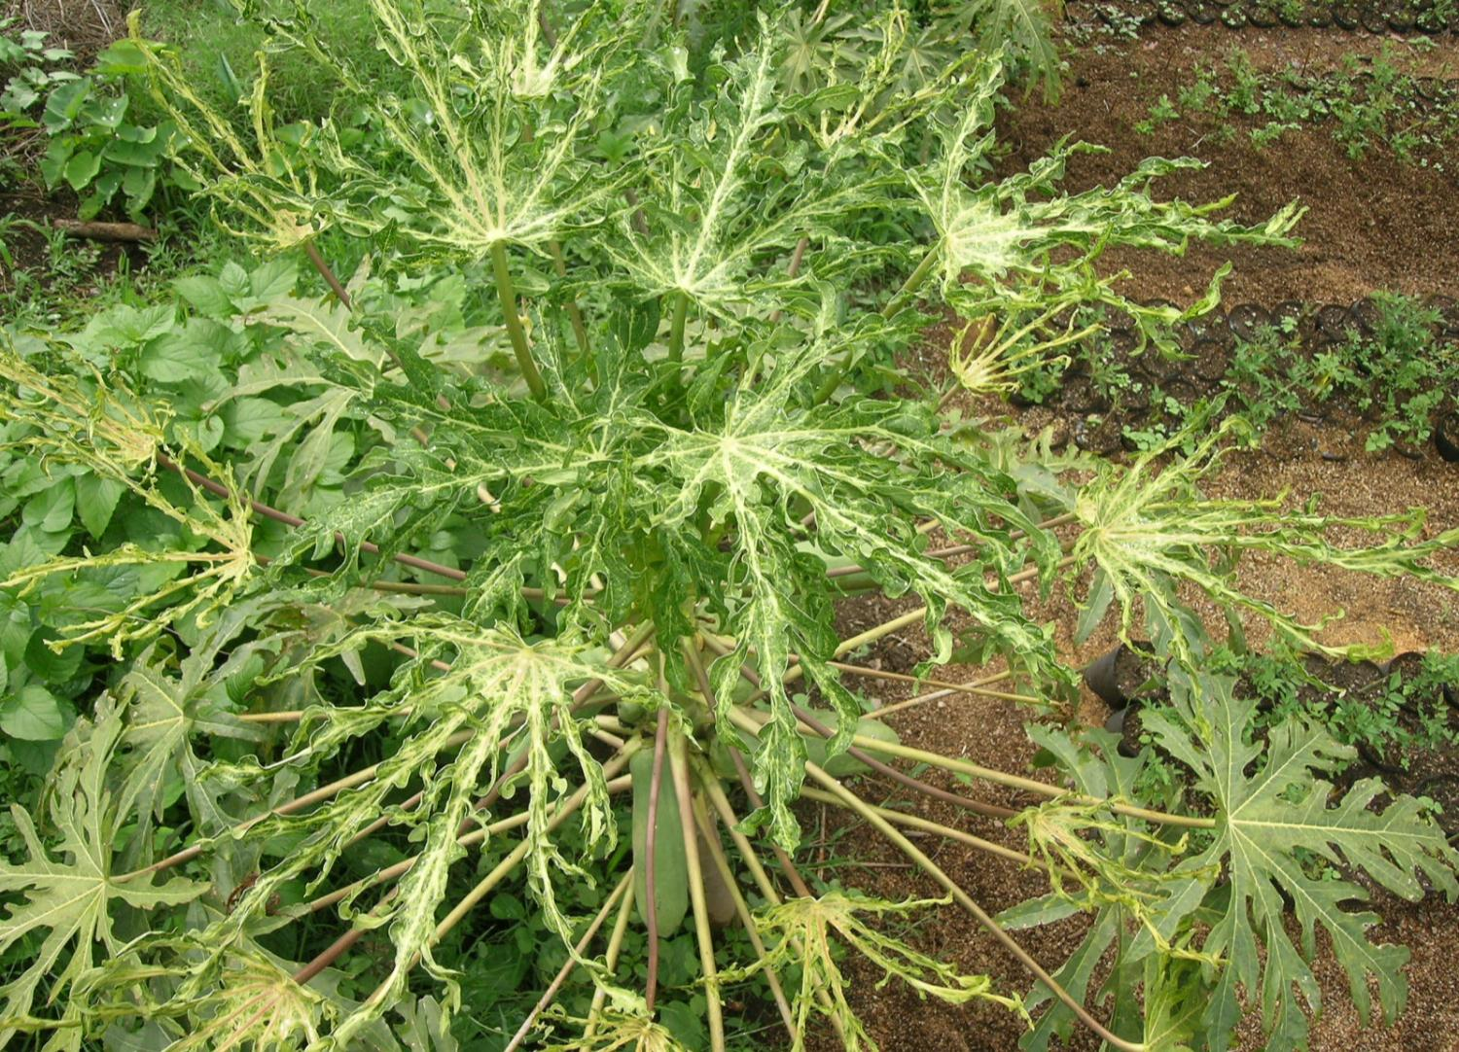
ELIMINATION 17
FUNGUS
WATER MOULD
BACTERIA
VIRUS
VIRUS
PHYTOPLASMA
NEMATODE
INSECT
MITES
ANIMALS & BIRDS
NUTRIENTS
?
PHY’CAL & HERB’IDE
Papaya
Nicaragua
PLANTWISE TRAINING. MODULE 1: HOW TO BECOME A PLANT DOCTOR. BEING A DETECTIVE: LEARNING MORE ABOUT CAUSES
Notes:
The leaves of this papaya plant have not been eaten away by an insect. The lamina of the leaf is reduced into a thin strap-like structure. The leaves also have a mosaic pattern and are distorted. This is probably papaya ringspot virus causing the problem. Nothing else could produce such extreme symptoms. The “?” for the herbicide tab is there because herbicides can produce weird growth like this but this could not have been caused by herbicide as the dose required to have produced these extreme symptoms for such a length of time (the plant is not a young one) would have killed the plant.

Slide 27
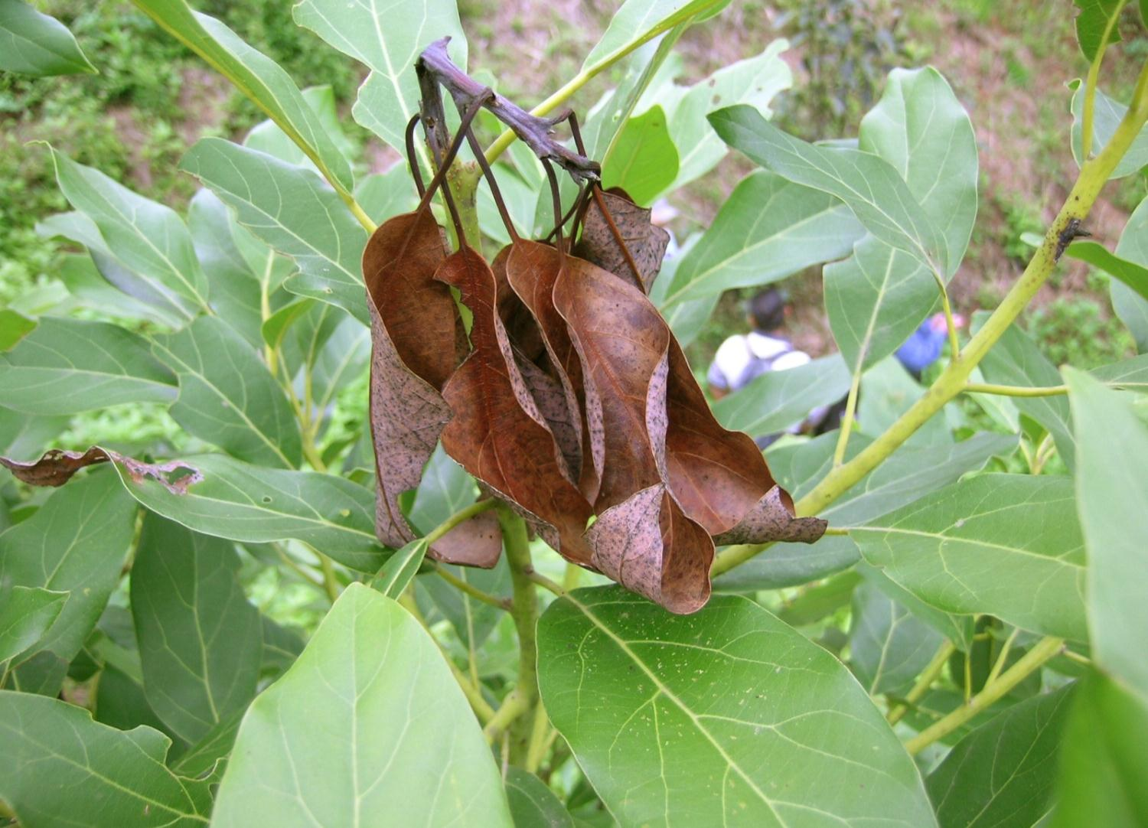
FUNGUS
ELIMINATION 18
FUNGUS
WATER MOULD
BACTERIA
BACTERIA
VIRUS
PHYTOPLASMA
NEMATODE
INSECT
INSECT
MITES
ANIMALS & BIRDS
NUTRIENTS
PHY’CAL & HERB’IDE
Avocado
Nicaragua
PLANTWISE TRAINING. MODULE 1: HOW TO BECOME A PLANT DOCTOR. BEING A DETECTIVE: LEARNING MORE ABOUT CAUSES
Notes:
The shoot-tip of this Avocado plant has started to die-back. This symptom is commonly associated with insects burrowing into the tip (or fungal or bacterial attack). It is not really possible to say definitively what the cause is based on this photograph, the plant doctors should split open the stem and look for insect larvae (or adults). The small amount of browning on the leaf on the left should be ignored it is not related to the tip dieback.

Slide 28
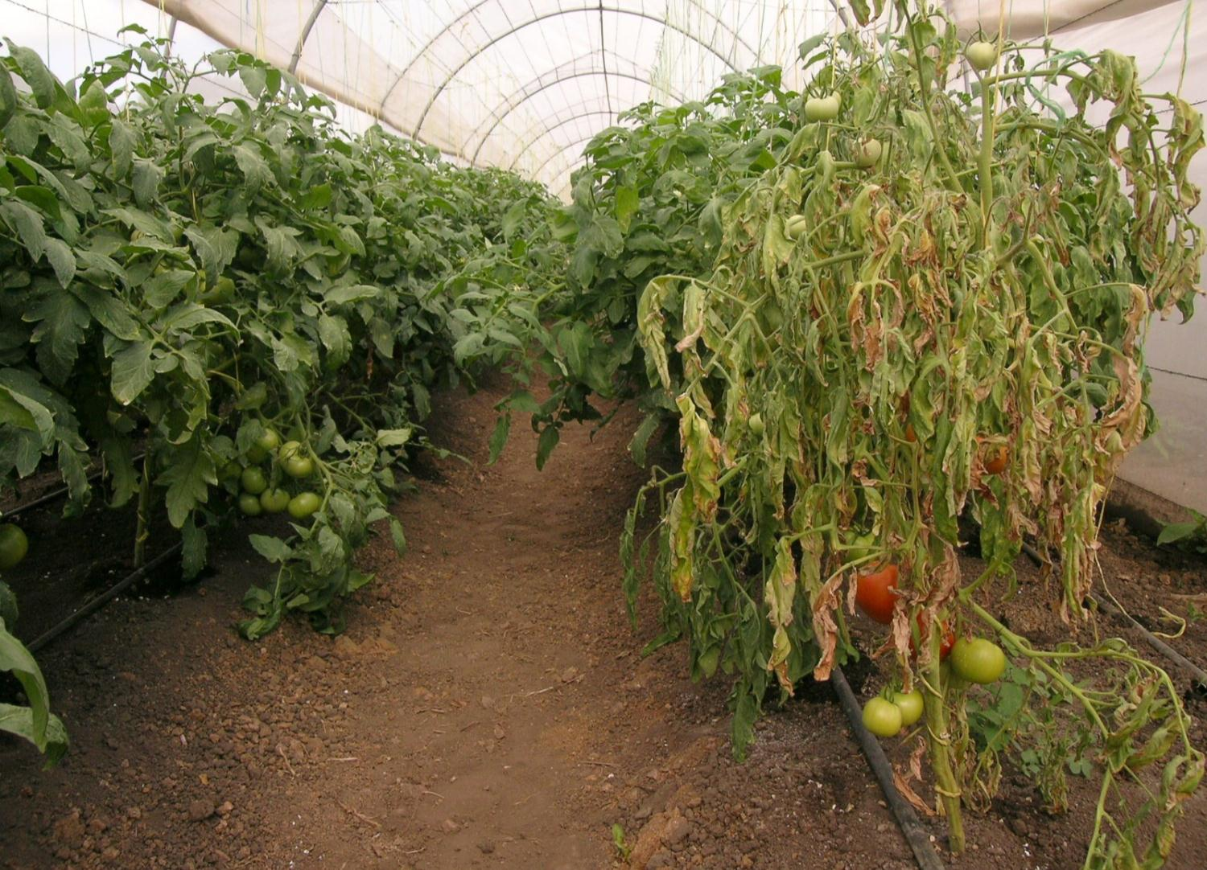
FUNGUS
ELIMINATION 19
FUNGUS
WATER MOULD
WATER MOULD
BACTERIA
BACTERIA
?
VIRUS
PHYTOPLASMA
NEMATODE
NEMATODE
INSECT
INSECT
MITES
ANIMALS & BIRDS
NUTRIENTS
PHYSICAL OR HERBICIDE
PHY’CAL & HERB’IDE
Tomato
Nicaragua
PLANTWISE TRAINING. MODULE 1: HOW TO BECOME A PLANT DOCTOR. BEING A DETECTIVE: LEARNING MORE ABOUT CAUSES
Notes:
The tomato plant in this image is wilting with browning of the leaves. The three most common causes of tomato wilt are nematodes, fungi and bacteria. The two question marks (?) indicate two other less likely causes. Insects can feed on the roots or lower stem causing the plants to wilt. Tomato spotted wilt virus can also cause wilting in tomato.
Fungus: look for internal staining of the stem
Watermould: unlikely as they generally do not cause wilting in tomato (although P. infestans is a massive problem). Look for sporulation.
Bacteria: bacterial streaming test
Virus: look for additional symptoms (ringspots) on the fruit.
Nematode: look for galls on the roots
Insect: look for insect larvae feeding on the roots or in the stem
Physical or herbicide: ask the farmers
V

Slide 29
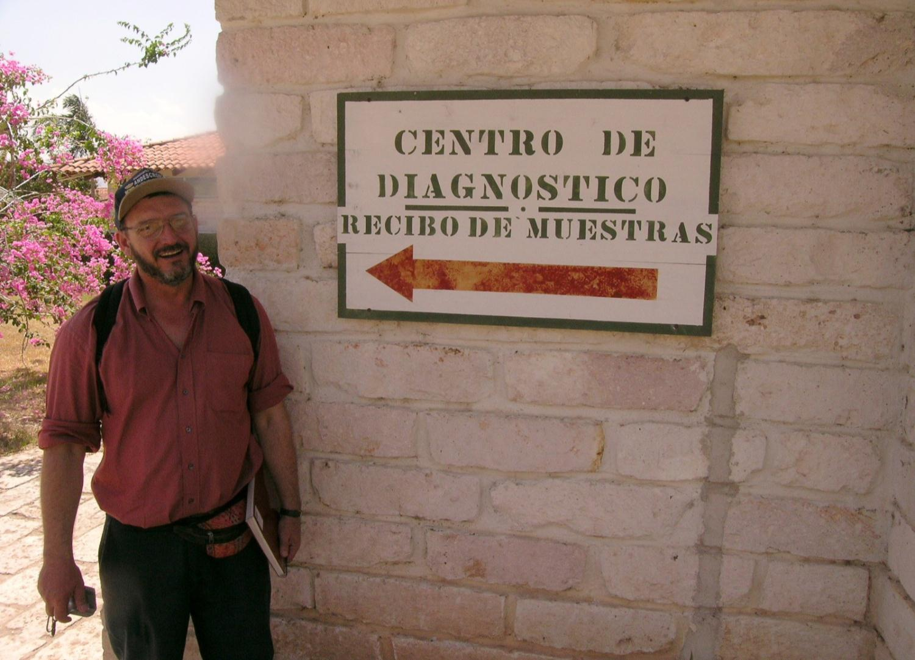
EXERCISE
C1-4
Common symptoms caused by pests (part 1)
PLANTWISE TRAINING. MODULE 1: HOW TO BECOME A PLANT DOCTOR. BEING A DETECTIVE: LEARNING MORE ABOUT CAUSES
Notes:
At this point we are asking the trainees to do their first bit of diagnosis. They do not have the large A3 ready reckoner at this point and they will be feeling quite nervous.

Slide 30
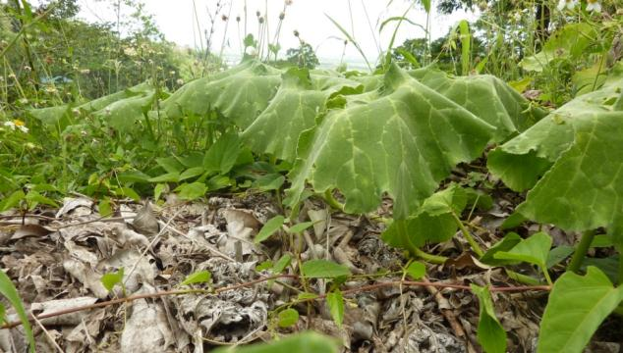
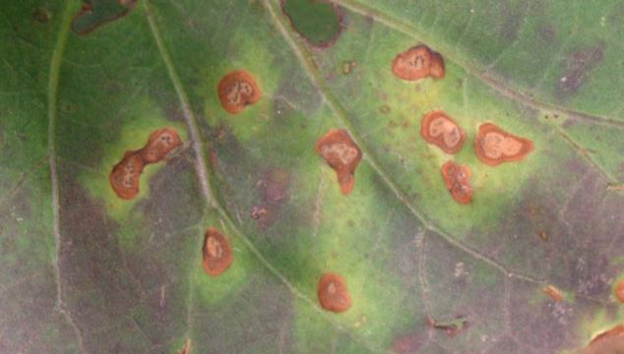



SYMPTOM EXAMPLES
Wilt
Leaf spots
Witches broom
Canker
Mosaic
PLANTWISE TRAINING. MODULE 1: HOW TO BECOME A PLANT DOCTOR. BEING A DETECTIVE: LEARNING MORE ABOUT CAUSES
Notes:
This slide is a reminder to the participants of what the symptoms look like that will be used in the classroom exercise.
In the exercise they are asked to use their exisiting knowledge to attempt to fill in the grid. Let them break up into small groups (just with the people they are sitting with) and spend a short while discussing the grid (about 5 minutes). Then go into the next slide.

Slide 31
C1-4 ANSWERS
Symptom | Fungus | Water mould | Bacteria | Virus | Phyto-plasma | Nematode | Insect | Mites | Animals & birds | Nutrients | Physical & herbicide
Wilt
Y
Y
Y
N
N
Y
Y
N
N
N
Y
Leaf spot
Y
Y
Y
N
N
N
Y
N
N
Y
Y
Witches broom
Y
N
N
N
Y
N
N
Y
N
N
Y
Canker
Y
N
Y
N
N
N
N
N
N
N
N
Mosaic
N
N
N
Y
N
N
Y
Y
N
Y
N
PLANTWISE TRAINING. MODULE 1: HOW TO BECOME A PLANT DOCTOR. BEING A DETECTIVE: LEARNING MORE ABOUT CAUSES
Notes:
This slide gives the answers to C1-4. Note that this table captures the most common (likely) symptoms ascribed to a group. There will almost always be an exception as plant pests and diseases are very diverse. Where an answer is given in red, there are examples of where the opposite to the answer can occur but is rare. There is no need for the trainees to scribble this down information as you are going through it as this the same information on the A3 ready reckoner.
There is a LOT of information on this slide and it is all repeated in the Diagnostic Field Guide and the Handout A3 ready reckoner.
DO NOT get into a discussion on the colour of the letters and whether a red Y should be a red N. It is a very general attempt to sum up the whole of plant pathology and entomology and plant nutrition on a single sheet. Of course there will be generalisations, if the trainees know of exceptions that is fine and if they don’t then warn them that there are exceptions to the rules on the page.

Slide 32
When at a plant clinic what are the most likely causes:
C1-4 ANSWERS
Symptom | Fungus | Water mould | Bacteria | Virus | Phyto-plasma | Nematode | Insect | Mites | Animals & birds | Nutrients | Physical & herbicide
Wilt
Y
Y
Y
N
N
Y
Y
N
N
N
Y
Leaf spot
Y
Y
Y
N
N
N
Y
N
N
Y
Y
Witches broom
Y
N
N
N
Y
N
N
Y
N
N
Y
Canker
Y
N
Y
N
N
N
N
N
N
N
N
Mosaic
N
N
N
Y
N
N
Y
Y
N
Y
N
PLANTWISE TRAINING. MODULE 1: HOW TO BECOME A PLANT DOCTOR. BEING A DETECTIVE: LEARNING MORE ABOUT CAUSES
Notes:
The yellow boxes are the causes that should be considered at plant clinics as they are the most likely to be the cause.
Whilst the whole table attempts to summarise all symptoms the ones in the yellow boxes will be the day to day activity of plant doctors at plant clinics.
All of the boxes with a “Y” inside can cause the symptom indicated but some are more common than others.
Fungus has a red Y for Witches broom because it only causes this symptom in mango (mango malformation disease).
There is only one herbicide that will cause witches broom. Grow back following glyphosate treatment will often appear as a witches broom.
Leaf spots and viruses is a tricky one. Spots can develop but they are generally considerably different compared to those caused by fungi water moulds and bacteria.

Slide 33
EXERCISE
C1-5
Common symptoms caused by pests (part 2)
PLANTWISE TRAINING. MODULE 1: HOW TO BECOME A PLANT DOCTOR. BEING A DETECTIVE: LEARNING MORE ABOUT CAUSES
Notes:
This slide leads into the classroom exercise C1-5

Slide 34





SYMPTOM EXAMPLES
Yellowing
Galls
Distortion
Small leaves
Necrosis/drying
PLANTWISE TRAINING. MODULE 1: HOW TO BECOME A PLANT DOCTOR. BEING A DETECTIVE: LEARNING MORE ABOUT CAUSES
Notes:
This slide is a reminder to the participants of what the symptoms look like that will be used in the classroom exercise.
It is the same activity as the previous slides. Do not spend too long on this activity (about 5 minutes is enough).

Slide 35
C1-4 ANSWERS
Symptom | Fungus | Water mould | Bacteria | Virus | Phyto-plasma | Nematode | Insect | Mites | Animals & birds | Nutrients | Physical & herbicide
Yellowing
Y
Y
Y
Y
Y
Y
Y
Y
N
Y
Y
Distortion
N
Y
N
Y
Y
N
Y
Y
N
Y
Y
Small leaves
N
Y
N
Y
Y
N
N
Y
N
N
Y
Galls
N
N
Y
N
N
Y
Y
Y
N
N
N
Drying necrosis
Y
Y
Y
N
N
Y
Y
N
Y
Y
Y
PLANTWISE TRAINING. MODULE 1: HOW TO BECOME A PLANT DOCTOR. BEING A DETECTIVE: LEARNING MORE ABOUT CAUSES
Notes:
This slide gives the answers to C1-4. Note that this table captures the most common (likely) symptoms ascribed to a group. There will almost always be an exception as plant pests and diseases are very diverse. Depending on how much you know you will find fault with this table. The question that has to be addressed is to which exceptions to we bring to the attention of the trainees. It may be one example but it is widespread (such as red ring of coconut which attacks the above ground parts of a plant) or a rule that does not really work very well such as viruses not causing necrosis as they can do in some cases. Where an answer is given in red, there are sufficiently important exceptions to raise the issues.

Slide 36
When at a plant clinic what are the most likely causes:
C1-4 ANSWERS
Symptom | Fungus | Water mould | Bacteria | Virus | Phyto-plasma | Nematode | Insect | Mites | Animals & birds | Nutrients | Physical & herbicide
Yellowing
Y
Y
Y
Y
Y
Y
Y
Y
N
Y
Y
Distortion
N
Y
N
Y
Y
N
Y
Y
N
Y
Y
Small leaves
N
Y
N
Y
Y
N
N
Y
N
N
Y
Galls
N
N
Y
N
N
Y
Y
Y
N
N
N
Drying necrosis
Y
Y
Y
N
N
Y
Y
N
Y
Y
Y
PLANTWISE TRAINING. MODULE 1: HOW TO BECOME A PLANT DOCTOR. BEING A DETECTIVE: LEARNING MORE ABOUT CAUSES
Notes:
The yellow boxes are the causes that should be considered at plant clinics as they are the most likely to be the cause. All of the boxes with a “Y” inside can cause the symptom indicated but some are more common than others.
The yellow boxes are to indicate the most likely causes, for example water moulds can cause little leaves to develop but this is an unusual symptom for them to produce and it is unlikely that they will be brought to a clinic.

Slide 37

Thank you
PLANTWISE TRAINING. MODULE 1: HOW TO BECOME A PLANT DOCTOR. BEING A DETECTIVE: LEARNING MORE ABOUT CAUSES
Notes:
The trainees will be overloaded with information at this point. Provide them with the A3 ready reckoner and allow them time to go through it to some extent. This page is the bedrock of Module 1.
To obtain permission to use this presentation or any of its components, please contact plantwise@cabi.org

Slide 38
© CAB International 2012. All rights reserved.
No part of this publication may be reproduced in any form or by any means, electronically, mechanically, by photocopying, recording or otherwise, without the prior permission of the copyright owners.
PLANTWISE TRAINING. MODULE 1: HOW TO BECOME A PLANT DOCTOR. BEING A DETECTIVE: LEARNING MORE ABOUT CAUSES
Notes:
To obtain permission to use this presentation or any of its components, please contact plantwise@cabi.org
It is now time to hand out the A3 ready reckoner OR to refer to it in the Diagnostic field guide.

